Slide 1
R&S®Web Application Firewall
Official Training 2018

Slide 2
Agenda

Slide 3
Agenda (Day 1)
Introduction
Global presentation
R&S products and integration
Customer Area
HTTP Essentials
HTTP basics
Important transactions
Regular expressions
R&S WAF – Installation

Slide 4
Agenda (Day 2)
R&S WAF – Workflow Management
R&S WAF - Security Engines

Slide 5
Agenda (Day 3)
R&S WAF - False Positive Management
R&S WAF – High Availability and Load Balancing
R&S WAF – Monitoring and Reporting
Certification (1h)

Slide 6
R&S Identity

Slide 7






















R&S key facts & figures
Fully-owned subsidiary of
Made in Europe technology
Customers in all verticals
and 30 countries
HQ in Paris
Staff of 70 30 in R&D Sales across EMEA
protected applications
They trust us
YEARS OF EXPERTISE IN APPLICATION SECURITY
35%
International turnover
Detect
Protect
“Rohde & Schwarz Cybersecurity is a good shortlist contender for organizations looking for a WAF appliance, combining ease of use and in-depth security features, especially those located in Europe”
Security for Web Apps & Web Services
Manage
Connect

Slide 8

Rohde & Schwarz group at a glance
Independent, family-owned company
Established 1933 in Munich, Germany
Global presence in over 70 countries
Net revenue EUR 1.92 billion in FY’16
90 percent export share
10,000 Employees worldwide
Incl. 6,000 in Germany

Slide 9


Rohde & Schwarz Cybersecurity
Certified & award-winning security solutions
+20 years experience in IT security
7 centers of competence in Germany, France & Denmark
450 Employees
Growth strategy
Combines 5 innovative European IT security companies
Growing to become a European cybersecurity leader
Notes:
Combining the infrastructure of a high-tech organization with the drive of startup companies

Slide 10
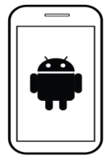






The European Trusted Supplier for Cybersecurity
Tap-proof communications
Voice encryption apps & devices
Secure messaging
Fax & Radio encryption
Secure endpoints
Full-disk encryption
Secure browsing & cloud
Secure desktop & mobile
Trusted management
CA, PKI, HSMs
Crypto management
Configuration, Policy
Firmware deployment
Secure applications
Web Application Firewall
Web Services Firewall
Web Access Management
Dynamic Application Security Testing
Document-centric encryption
Trusted solutions from a single source
Encrypted backbone / WAN
Layer 3 IP encryption
Layer 2 Ethernet encryption
Secure remote access
Secure networks & network analytics
NextGen Firewall & UTMs
Deep Packet Inspection
Network vulnerability management

Slide 11




Application security tools for the digital era
Detect
R&S Vulnerability Manager
Manage
Identify assets
Detect & prioritize vulnerabilities
Remediate to reduce attack surface
All R&S products
Simplify deployment
Automate response to dangerous user behaviors
Monitor & report, perform forensics analysis
Protect
R&S Web Application Firewall R&S Web Services Firewall
Connect
Block attacks, prevent data leakage & identity theft
Secure APIs & machine-to-machine communications
Evaluate user reputation
R&S Web Access Manager
Enforce authentication policy
Simplify security for users (SSO)
Adapt authentication to user context

Slide 12
R&S’s cloud services & software products

Slide 13



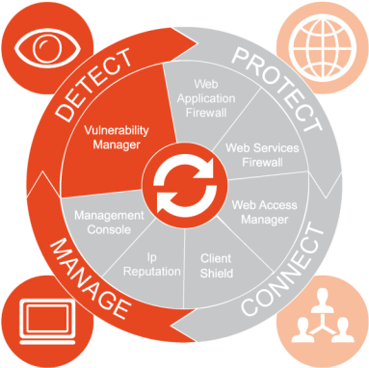
R&S Vulnerability Manager
Key functions
Differentiators
Assets discovery
Network, system & app-layer vulnerability Identification
Prioritization based on asset value (CIA) & criticality
Remediation tickets
Concise operational reports with links to CVEs, trending reports for Management
LDAP integration
Probes deployment
Proxy-mode for authenticated pages
Swagger integration
Comprehensive view across entire IT (20+ scanners)
Concise, actionable reports
Internal ticketing, integration with 3rd party tools
Form factor choice:
Enterprise & Portable Editions for internal tests
Cloud Edition for external testing
Integration with R&S WAFs for virtual patching
Data privacy: information remains in your control, not subject to Patriot Act

Slide 14

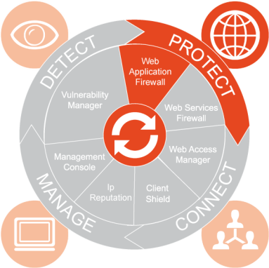
R&S Web Application Firewall (WAF)
Key functions
Differentiators
Visual policy configuration & traffic control (workflow)
Application Security Automation
Application learning (http & REST traffic)
Multiple security engines:
ICX (generic patterns)
Scoring List (heuristics)
Adv. Detection Engines (grammatical analysis)
Bot protection
User Reputation Scoring
Virtual patching
Customizable dashboard for monitoring & reporting
Productive admin. environment
Workflow configuration
Application profiling & predefined security policies
Traffic learning (sitemap)
Orchestration API
Effective against OWASP Top 10 & zero-day attacks, bots & evasion attempts
Positive & negative security
Chaining multiple engines for maximum security efficiency
Adjust response to changing user context & behavior
Add-on capabilities:
Web Services Firewall for API & Web Services routing & security
Web Access Manager for Web SSO & Adaptive Authentication
Integration with R&S Vulnerability Manager

Slide 15

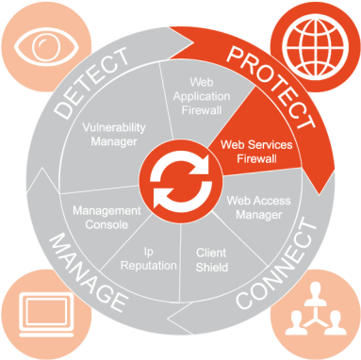
R&S Web Services Firewall (WSF)
Key functions
Differentiators
Visual policy configuration & traffic control (workflow)
Web Services routing
REST traffic learning (sitemap)
XML/SOAP schema validation
XML message signature & encryption
Web Services member authentication
Web Services specific attack signatures
Virtual patching
Customizable dashboard for monitoring & reporting
Productive admin. environment
Workflow configuration
Application profiling & predefined security policies
Traffic learning (sitemap)
Orchestration API
API Gateway combined with best-of-breed Web Services security
SOAP/XML & REST/JSON routing & filtering
Data integrity & message validation
XML signature & encryption
Standalone or integrated with WAF

Slide 16

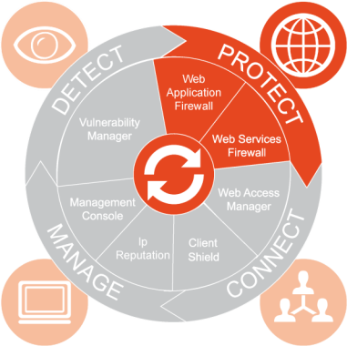
R&S Cloud Protector
Key functions
Differentiators
Fully-automated cloud service
Simplified set-up, administration & false positive management
3 predefined security policies
SSL off-loading
Highly-redundant, auto-scaling
Monthly, weekly and daily reports
Distributed administration based on roles
Management API
Network-layer anti-DDoS protection in Enterprise plan
Scalable pricing (starts at 29$/month/site)
Robotic WAF with minimal administration
Known attack & zero-day protection, anti-evasion
Multiple engines tuned to maximize protection & minimize false positives
Advanced security, incl. heuristics, grammatical analysis, sandboxing
Same technology as enterprise WAF, certified by French government
Sovereign cloud (not subject to Patriot Act)
Available as software for partners to operate (vCloud)
Ongoing enhancements & new feature additions

Slide 17

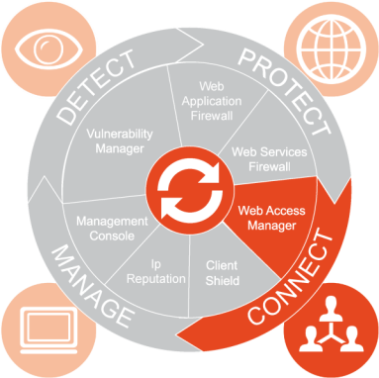
R&S Web Access Manager (WAM)
Key functions
Differentiators
Visual policy configuration & traffic control (workflow)
Application anonymization
Authentication learning
Web Single Sign On
User authentication portal
Self-help & password policy management
All authentication methods supported
LDAP
HTTP Basic
HTTP Form
X509
OTP/SMS
Kerberos
NTLM
Customizable dashboard for monitoring & reporting
Productive admin. environment
Workflow configuration
Application profiling & predefined security policies
Traffic learning (sitemap)
Orchestration API
Granular user & application provisioning
Agent-less, no change to web applications
Credentials auto-learning
Log replay for forensics analysis
Adaptive authentication (with R&S WAF)
Standalone (inside the network), or on WAF (DMZ)

Slide 18

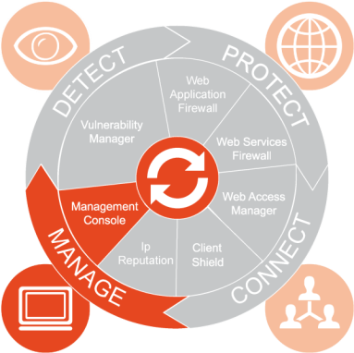
R&S Management Console
Centralized Provisioning
A unique platform to manage all devices and applications
Global view
Global Monitoring & Reporting
Key Performance & Security Indicators
Real-time alerting
Role-Based Access Control
Increased control
Reduced cost of ownership
SIEM Integration
Kibana app with drill-down capabilities
Event correlation

Slide 19













Protection, detection & automated response
Vulnerability identification & remediation
REST
Web Services
SOAP
Legitimate Web Services
Mail Server
HTTP
HTTPS
Legitimate Users
Applic.
Server
Network Firewall
Database
Server
Dangerous requests blocked
Legitimate requests allowed
Hackers
Highly available, reverse-proxy based, in-line filtering
Adaptive Authentication
Web Single Sign On
File Server
Storage
Malicious Bots
Notes:
Unlike Imperva who only monitor and alert

Slide 20












Embed security in the software development lifecycle
DAM/RASP
SIEM
Firewall
Router
Virtual patching
Developers
Application
Code
Users
Vulnerability
Report
Security Policy
Authorization
Policy

Slide 21






On-premises, in the Cloud & in Hybrid Mode
All products cloud-ready since 2012
On Amazon and Azure marketplaces
Latest platforms : OpenStack, Google, Vmware
Partnering with global and sovereign cloud providers
Hosting Partner Purchase Program
Exploring technology partnerships to automate cloud deployments
Differentiator: WAF-as-a-Service
www.cloudprotector.com
Unique on the market
Helping customers transition to the cloud
Cloud Protector for MSPs

Slide 22







Web Application Security as a Service
Security
Simplicity
Monitoring
Website secured in 5 minutes
and for $29/month only
www.cloudprotector.com
Performance
Scalability
Confidence

Slide 23
Support & Customer Area

Slide 24
Support Dream Team
Available via calls
+33 4 99 64 67 62
+33 4 99 64 67 64
Available via email
support@R&S.com
Customer area: Login onto my R&S
DENY ALL customers/partners can log onto My R&S database via our public web site at https://my.R&S.com/
A direct link is already available on the right header of our website http://www.R&S.com

Slide 25
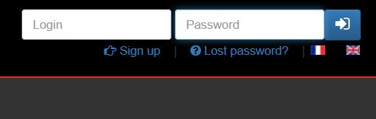
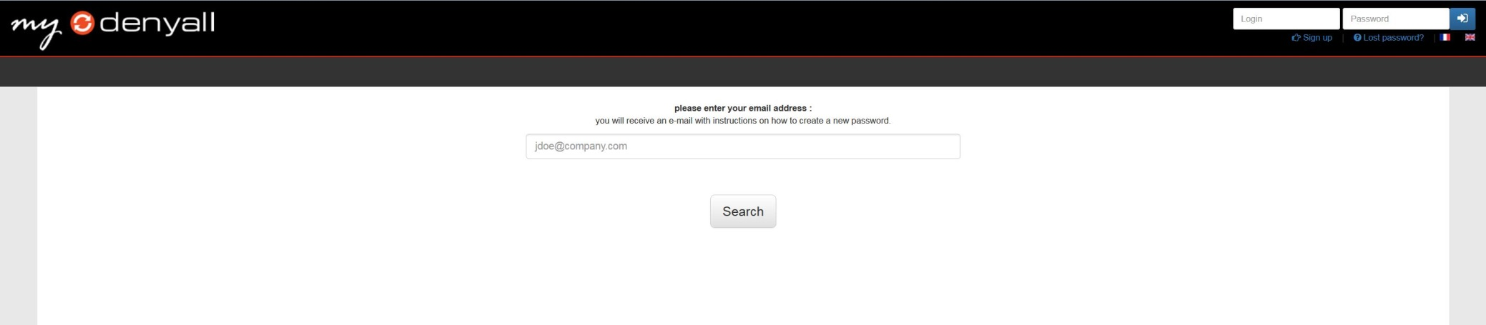
Wrong credential
Forgotten your password ?
Clik on lost password and follow the instruction, an email will be sent with instructions on how to create a new password.

Slide 26
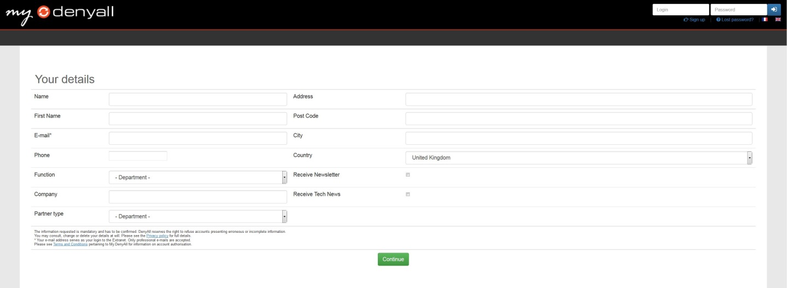
No Account
You don’t have a valid account ?
Click on sign up, complete the form and accept our General terms and Conditions. Our team will validate your registration.

Slide 27

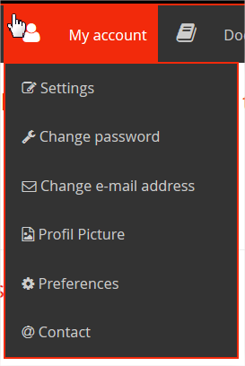
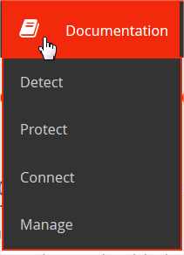
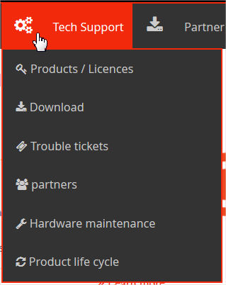
Customer area

Slide 28
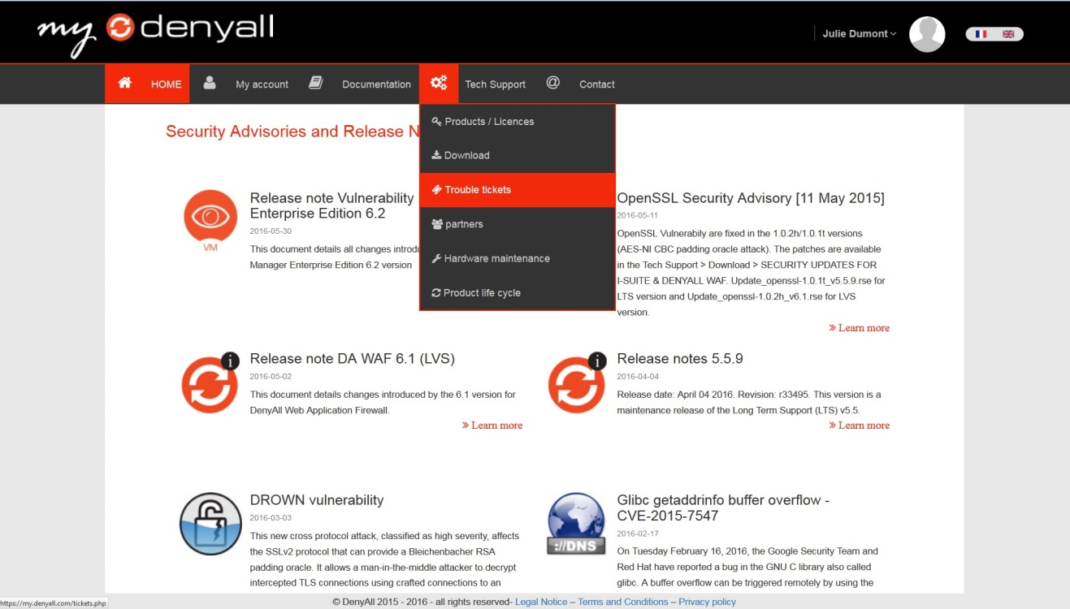
My first ticket
How to create a ticket on my R&S?
Clik on Tech support and select Trouble ticket.

Slide 29
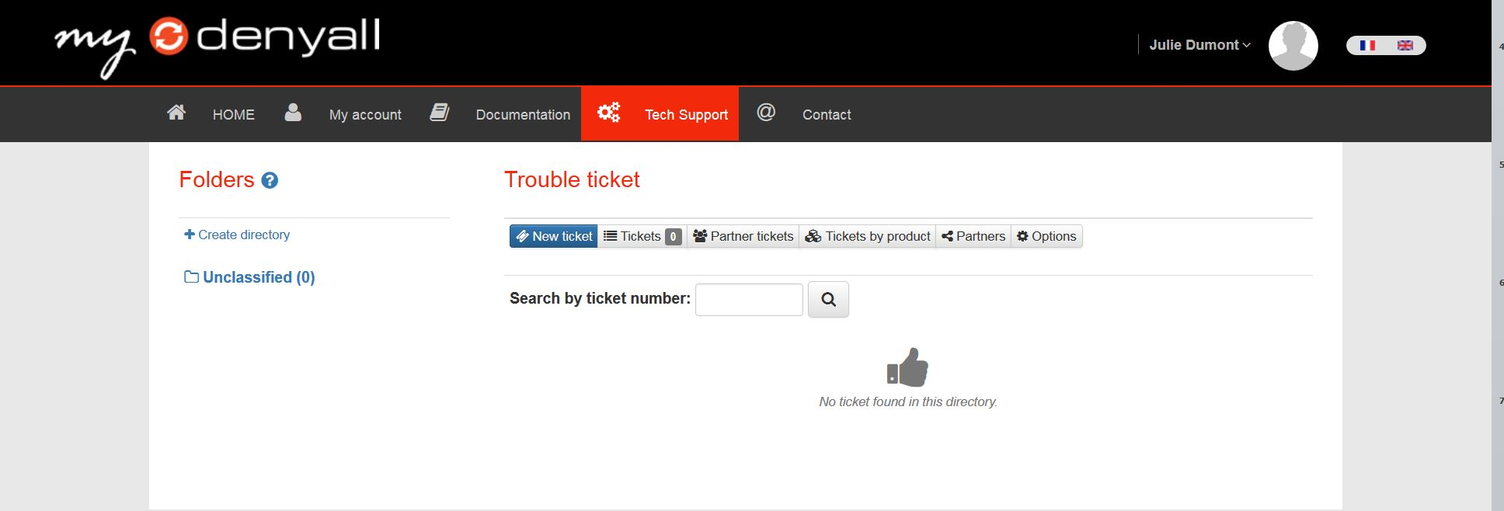
My first ticket
Select New ticket.

Slide 30
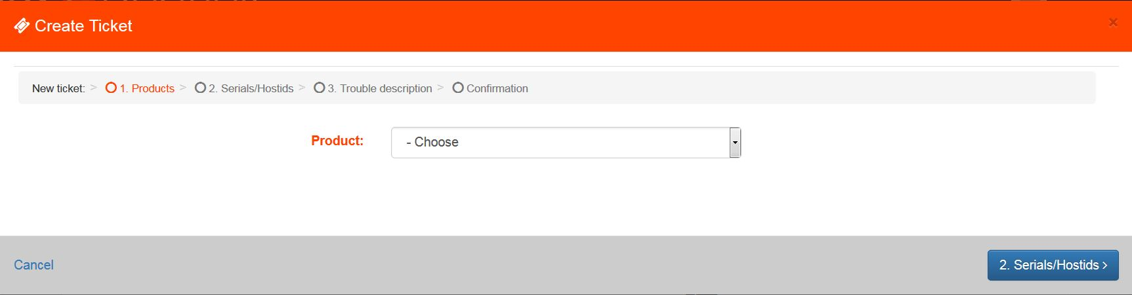
My first ticket
Choose your product and Submit

Slide 31
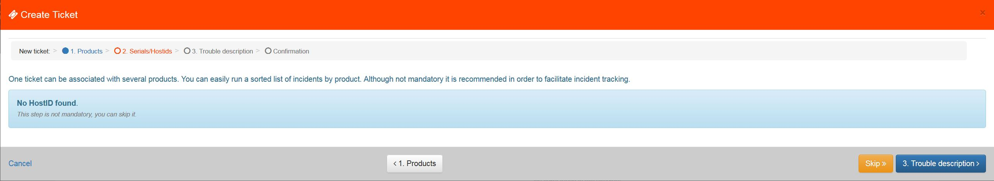
My first ticket
Select the Serials / HostID of the related Machien or skip this page.

Slide 32
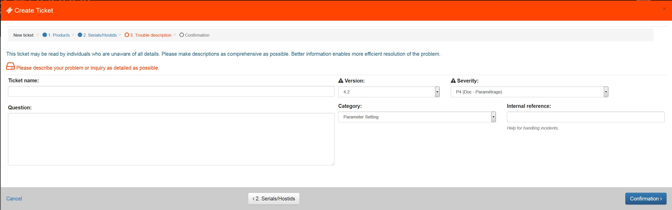
My first ticket
Fill in the form and confirm.

Slide 33
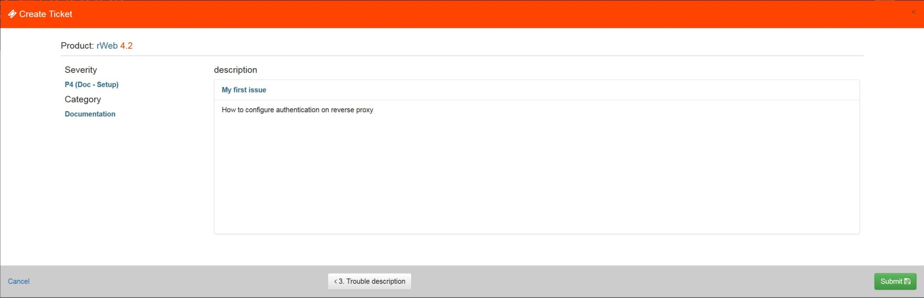
My first ticket
Verify informations and submit.

Slide 34
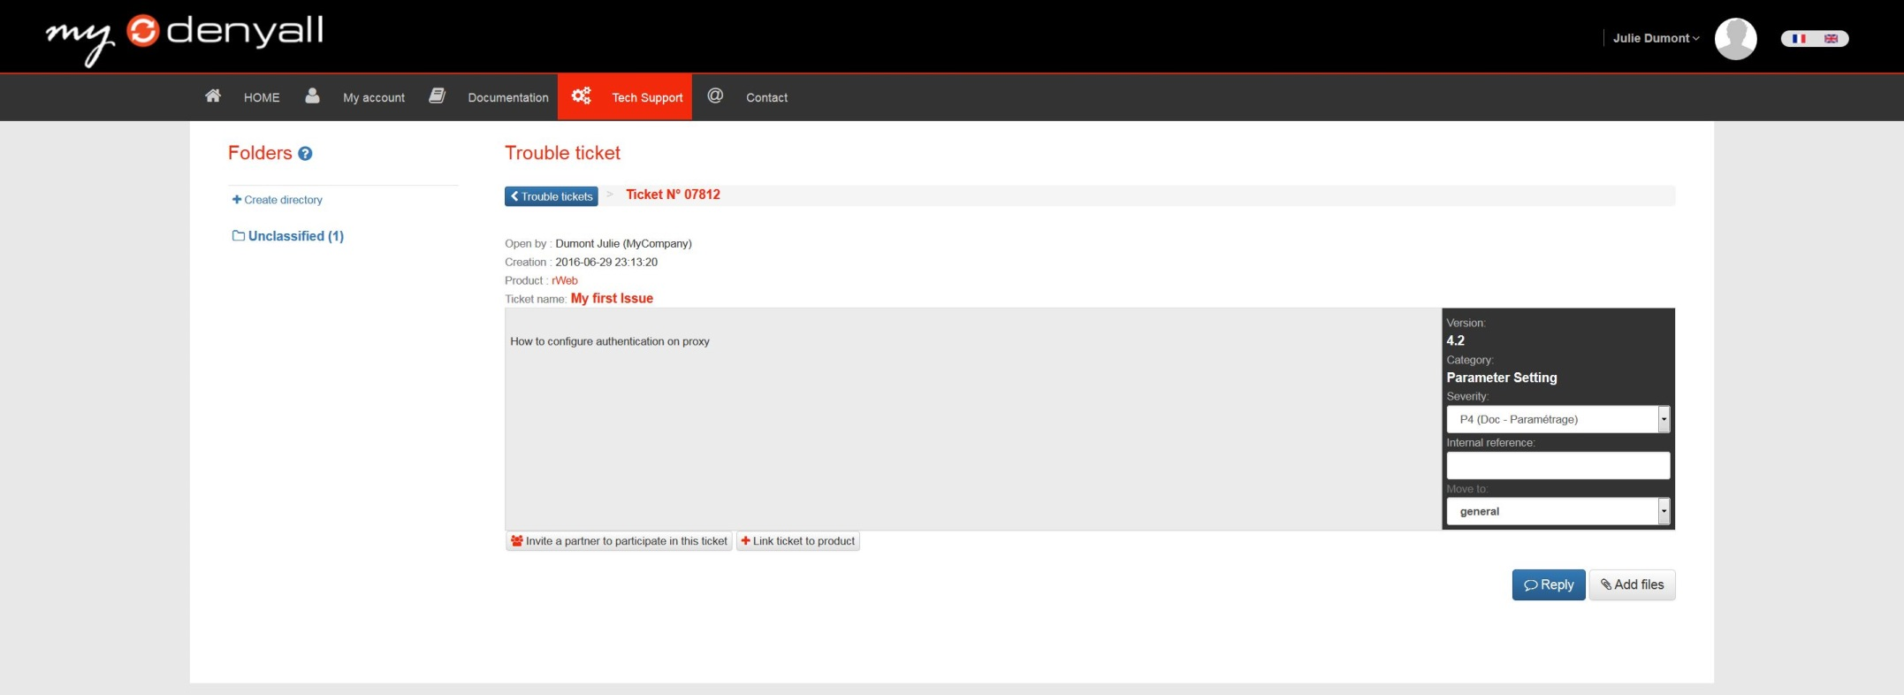
My first ticket
Add attachments if necessary.

Slide 35
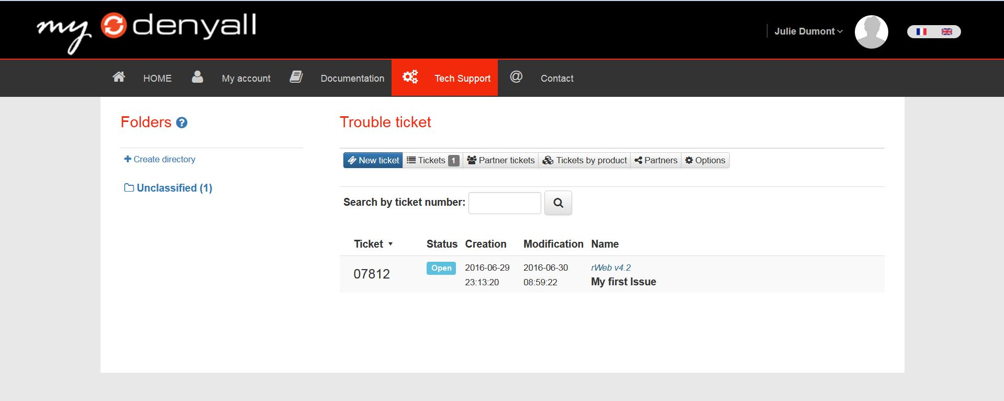
My first ticket
Your ticket is now available on your dashboard.

Slide 36
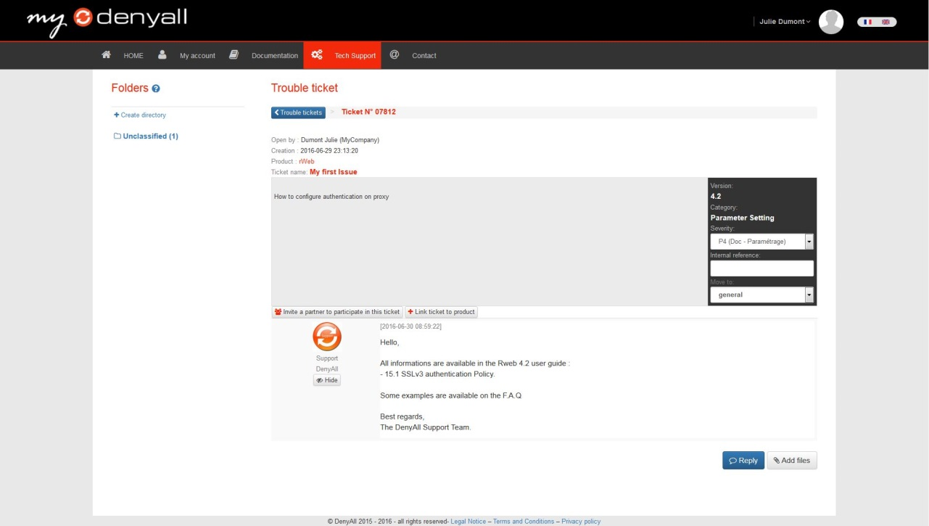
My first answer
After reception of the R&S notification, you have access to the support answer.
You can answer the curent ticket by selecting Reply

Slide 37
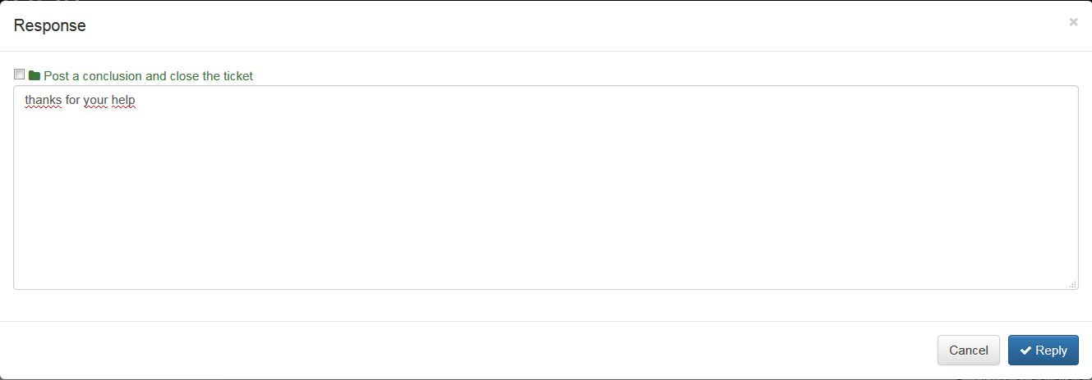
My first answer
Write your answer and reply. (you can close the case by checking the box in the upper left corner)

Slide 38
Priority levels definition & Response Time
Support offering | Premium Support | Standard Support
Office hours availibility | 8AM / 6PM CEST 5d/7 | 8AM / 6PM CEST 5d/7
After hours availibility | 24/7 | NO
Hardware Support
Advanced repair and replacement service (after diagnosis establishment by DELL or R&S) | Within 24H | J+2 (Business Day)
Call Response Time
Severity P1 : Product is down: critically effects customer production environment. No workaround yet available. | < 1 hour | < 1 business hour
Severity P2 : High: Product is impaired, customer production up, but impacted. No workaround yet. | 2 business hours | 4 business hours
Severity P3: Medium: a product function has failed, customer production not affected. Support is aware of the issue and a workaround is available. | 4 business hours | 8 business hours
Severity P4 : Low :Non-critical issue. Does not impact customer business. Feature, information, documentation, how-to and enhancement requests from the customer | 8 business hours | 8 business hours

Slide 39
Questions ?

