Slide 1
R&S®WAF Installation
Official Training 2018

Slide 2
Summary
Basic Concepts
Prerequisites
R&S®WAF Installation
Configuration
Challenge

Slide 3
Basic Concepts

Slide 4
Basic Concepts
}
Base
Option Option
What is a “Web Application Firewall” ?
Block requests having attack techniques
Hide sensitive information
What is “Web Application Delivery” ?
Add/set/unset any HTTP parts in Requests and/or Responses
Handle High Availability, Fault Tolerance and Load Balancing
What is “Web Access Management” ?
Handle WHO can access WHAT using authentication
What is “Web Service Firewall” ?
Handle Security of Webservices (XML/JSON)
IP reputation
} }

Slide 5
Basic concepts
Reverse Proxy
Apache instance
One or more per Appliance/VM
500 Mo RAM per RP
Handle tunnel(s)

Slide 6
Basic concepts
Tunnel
http://www.myapplication.com
One or more per Reverse Proxy (no limit)
A Listening IP/Port
HTTP behavior handled by a WORKFLOW

Slide 7
WAF Prerequisites

Slide 8
Prerequisites for a test environment
The virtual machine has to be installed with the following settings:
2 VCPU
Linux + CentOS 64 bits
RAM > 8 GB
Disk Space >= 20 GB
Network interface : 1+ as Bridge access/NAT/VLAN
Storage: DenyAll WAF 6.4 ISO file provided in the customer area

Slide 9
Prerequisites for a production environment
The virtual machine has to be installed with the following settings:
4+ CPUs
Linux + CentOS 64 bits
RAM > 16 GB
Disk Space >= 500 GB
Network interface : 2+ VMXNET3 recommended
Storage: DenyAll WAF 6.4 ISO file provided in the customer area

Slide 10
Installation

Slide 11
Installation
Start the virtual machine
Log in with default username and password : dashell/admin
Setup a manager using ‘Set as management’ option
Follow the wizard

Slide 12
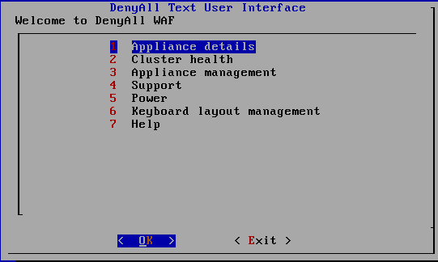
DenyAll Text User Interface
DA TUI: 1rst Box initialization then Box management
Connect with dashell user
Choose your keymap
Get appliance infos (name, admin ip, network configuration)
Cluster information (box status)
Configure Network & users, access system tools (top, ps , route, …), restart daemons
Logs, DB management, execute cpt, debug.dat generation
Shutdown, restart appliance
Change the keymap
List available commands

Slide 13
DenyAll Text User Interface
DA TUI commands are available in DenyAll WAF GUI
DA TUI is useful when you have no access to the GUI or if GUI is crashed

Slide 14
Installation
Some useful commands:
!ping 192.168.168.168
!ifconfig
!netstat –antp | grep 3001
!route -n

Slide 15
Installation
Let’s connect to the virtual machine with the Graphical User Interface
Install the GUI
Launch the GUI
Connect with the login/password and ip address previously defined through the wizard /

Slide 16

LAB Architecture
192.168.1.1(0-9):3001
192.168.1.2
192.168.1.3
HTTP(S)
HTTP
Network
192.168.0.X/24

Slide 17
LAB architecture
10 VM with DAWAF configured in Manager mode
Going from 192.168.1.10 to 192.168.1.19
Netmask: 255.255.254.0
Gateway: 192.168.0.254
DA Shell login: dashell
DA Shell Password: admin
GUI Login: superadmin
GUI Password: changeme

Slide 18
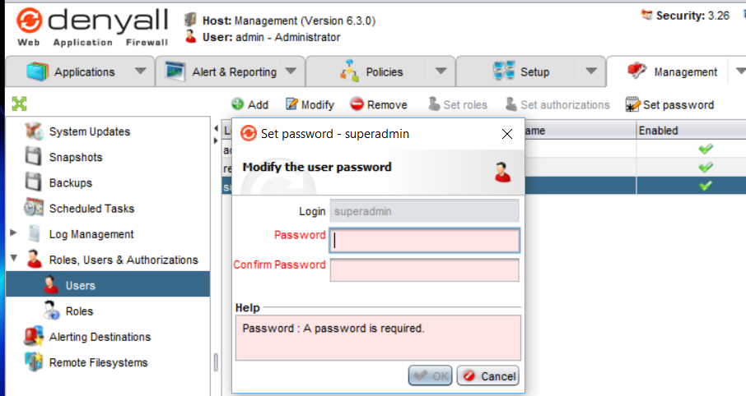
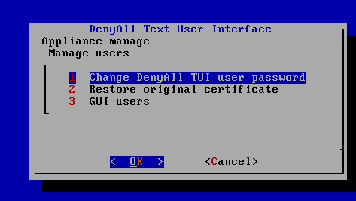
Challenges
Install the GUI version 6.3
Log in with default username and password
GUI: superadmin/changeme
CLI: dashell/admin
Change GUI password
Change CLI password

Slide 19
Configuration

Slide 20
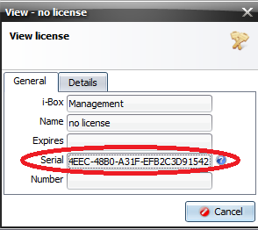
License
Provide a license
Go to the Licenses sub-section
Double click on the first element
Retrieve the serial number of your appliance

Slide 21
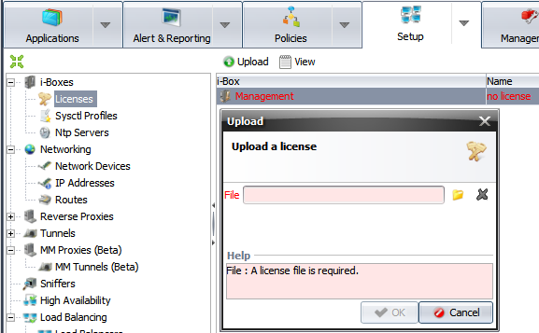
License
Provide a license
Get your license
Upload it in the GUI

Slide 22
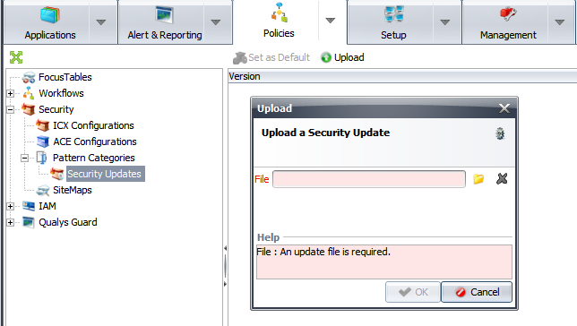
Security update
Security update
Download it from https://my.denyall.com/maj.php
Upload it in the GUI

Slide 23
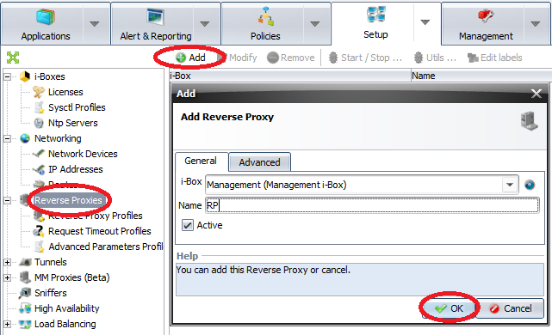
Reverse proxy
Create a reverse proxy
In the setup tab, go to the
reverse Proxy section
Click on Add
Choose the i-Box that your
reverse proxy will be running on
Name it
Click on the OK button

Slide 24
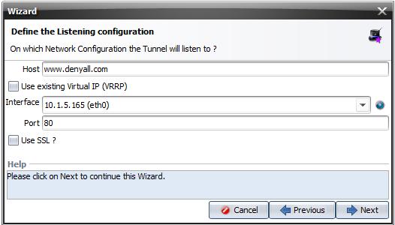
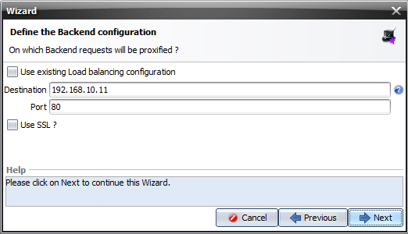
Tunnel
Create a tunnel
In the Applications tab, click on Add
and then on Wizard
Host : Server name
Interface: Virtual machine
Destination: Server IP
address

Slide 25
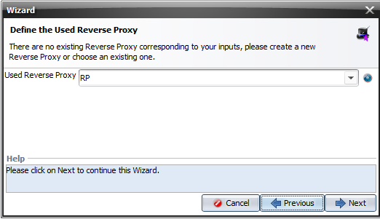
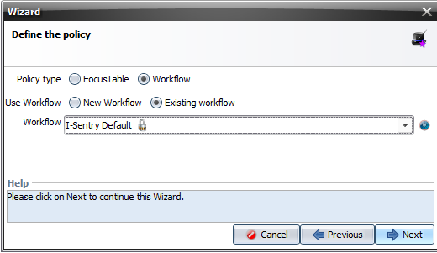
Tunnel
Create a tunnel
Choose the reverse proxy previously
created
Check Workflow button
Check Existing workflow button
Choose I-Sentry Default

Slide 26
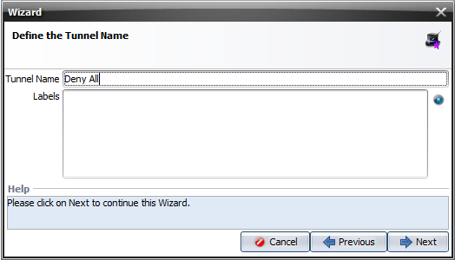
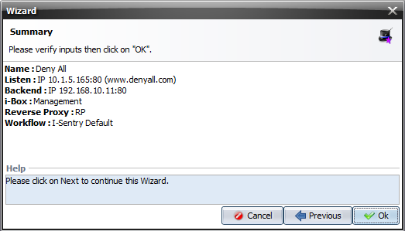
Tunnel
Create a tunnel
Choose a tunnel name
Check your information are
correct

Slide 27
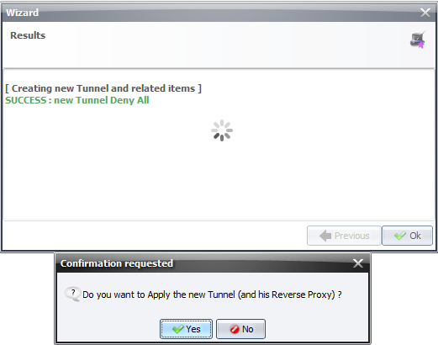
Tunnel
Create a tunnel
Final step, click on Ok
then on Yes to push your
modifications

Slide 28
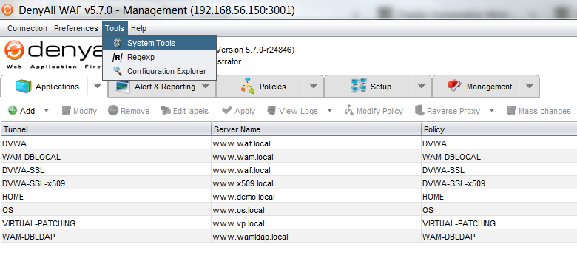
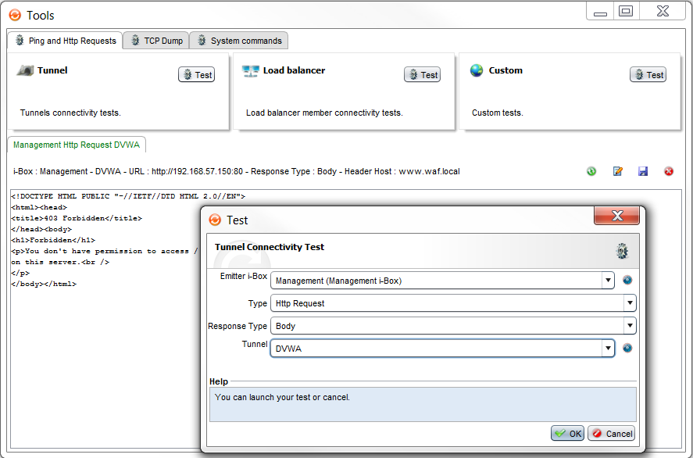
Tunnel
Test the tunnel
Let’s see if the DenyAll WAF can communicate with the application

Slide 29
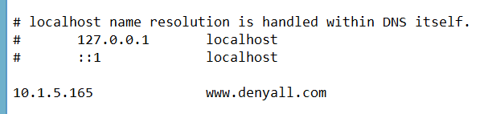
Tunnel
Test the tunnel
Next, let’s use our application through the tunnel
Update your host file to bypass DNS resolution and setup your FQDN on the listening IP address of your tunnel
C:\Windows\System32\notepad.exe C:\Windows\System32\drivers\etc\hosts

Slide 30
Configuration
Test the tunnel
Close previously opened browser and open a new one
Type the FQDN in the address bar
If it’s OK, let’s test a bad request Example: http://my.denyall.com/?test=cmd.exe

Slide 31
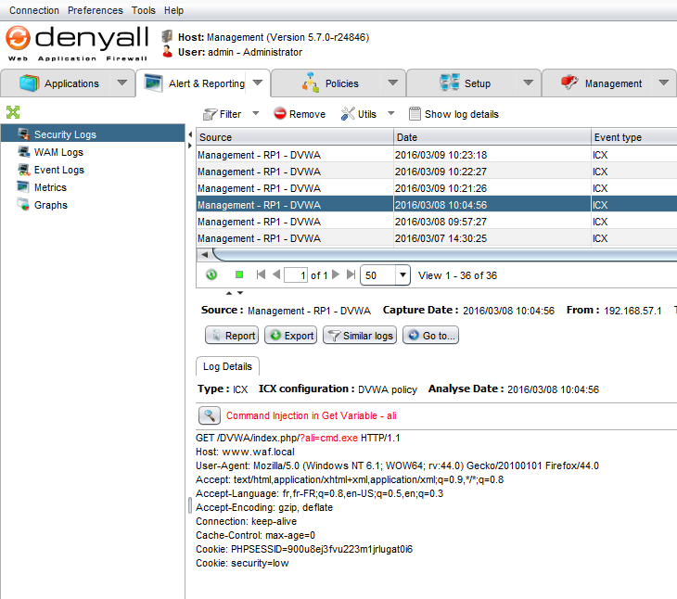
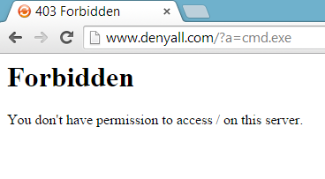
Configuration
Test the tunnel

Slide 32
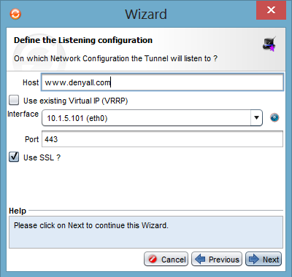
Configuration
Create HTTPS tunnel
In the Applications tab, click on Add
Host : Server name
Interface: Virtual machine
Check Use SSL
Destination: Server IP
address

Slide 33
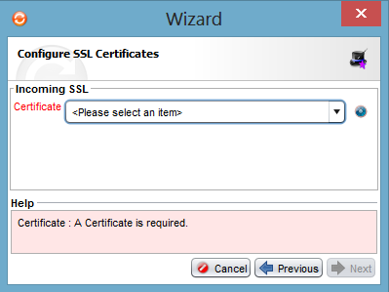
Tunnel
Create HTTPS tunnel
Final step, you will need a certificate

Slide 34
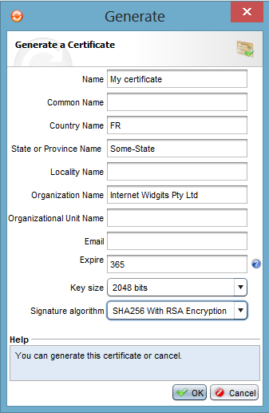
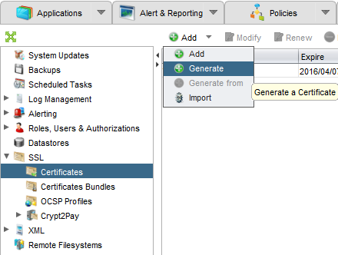
Tunnel
Create HTTPS tunnel
Generate a certificate
Management tab, Add, Generate

Slide 35
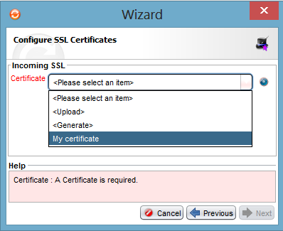
Tunnel
Create HTTPS tunnel
Back to Applications tab, wizard
Choose your certificate

Slide 36
Upgrade
Download the latest Administration Interface from https://my.denyall.com
Log into the Management iBox with the new Interface (6.4.1)
Upload the RSE file in Management >> System Updates
Back up all the configurations and download the backup file
Select the Management iBox and click Install
Perform an Apply all

Slide 37
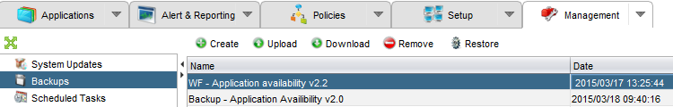
Configuration
Backup
Management >> Backups
Manage backup up and restoring the configuration
These are available actions:
Create
Upload
Download
Restore

Slide 38
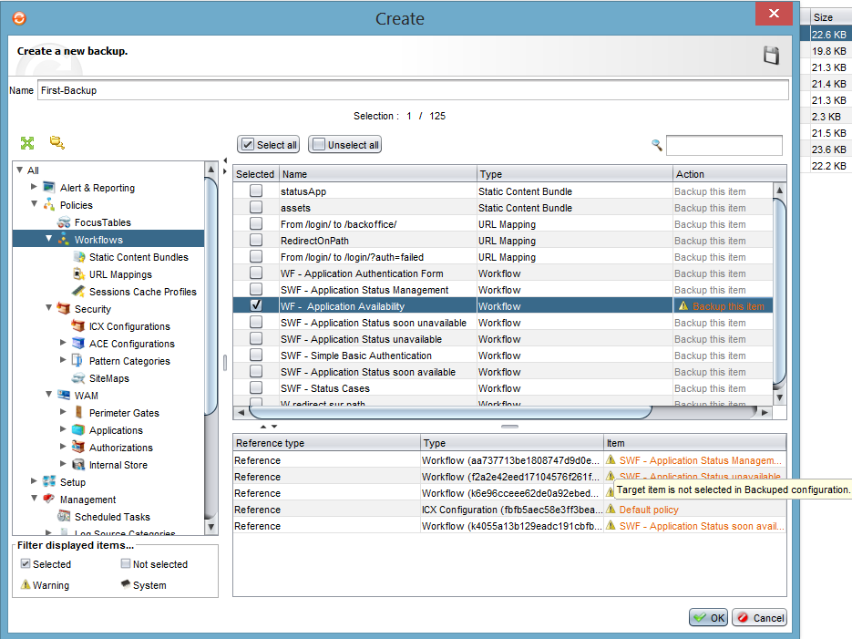
Configuration
Creating a backup
Select items to be included in your backup
Problems with dependencies are indicated in orange text and a warning icon
A balloon tip is displayed
specifying the problem when
mousing over it

Slide 39
Configuration
Restoring a backup
Select all the elements to be copied to your configuration
They will be restored in the exact state in which is has been saved
Problems with dependencies will be indicated by a red text and a warning icon
Unresolved dependencies block the restoring of a backup

Slide 40
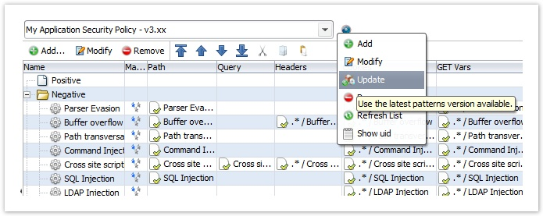
Configuration
Security update
In case your environment is already set up and where no interruption is tolerated:
Upload the security update
Make a copy of the security policy using “Save as…”
Update it

Slide 41
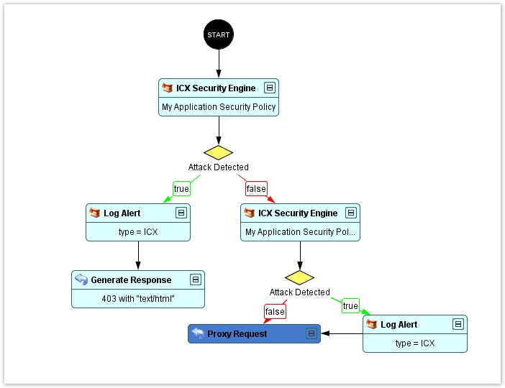
Configuration
Save it
Go to the Workflow section and make a copy of the workflow currently being used
Add a new ICX Security Engine node and a new Log Alert/Proxy Request
Associate the new ICX policy you
created previously with the new ICX Security
engine node (the second here)

Slide 42
Challenges
Provide your serial number to trainer
Install the received license file
Set up new http tunnel
Host : app.denyall.local
Interface: your IP
Port: 80
Destination:
IP :192.168.1.2
Port: 80
Workflow: DenyAll WAF Default
Set up new https tunnel
Generate self-signed certificate
Host : app.denyall.local
Interface: your IP
Port: 443
Destination:
IP :192.168.1.2
Port: 80
Workflow: DenyAll WAF Default

Slide 43
Challenges
Backup
Creating a backup for the http application
Remove http application
Restoring application with backup
Update WAF version
Upgrade from 6.3 to 6.5

