Slide 1
DenyAll WAF Workflow Management
Official Training 2018

Slide 2
Summary
Basic Concepts
Workflow Basics
Workflow Management
Security Policy
Challenge

Slide 3
Basic Concepts

Slide 4
Basic concepts
Workflow
A workflow is a chain of native bricks or (predefined) sub workflows
Add / modify / delete / control whatever you want in HTTP Requests and Responses
A single workflow can be used by many tunnels (or not)

Slide 5
Basic concepts
ICX
Pattern matching based Security Engine
Can be used by one or more Workflow (or not)
A request can be blocked by one or more reason
Resolve and Replay magic buttons

Slide 6
Basic Concepts
THE BIG VIEW
Apache Instance VirtualHosts
Appliance
TUNNEL
REVERSE PROXY
WORKFLOW
ICX
TUNNEL
REVERSE PROXY
WORKFLOW
ICX
TUNNEL

Slide 7
Basic Concepts
To keep in mind
Appliance
Reverse Proxy
IP/VIP
Tunnel
Workflow
ICX

Slide 8
Workflow Basics

Slide 9
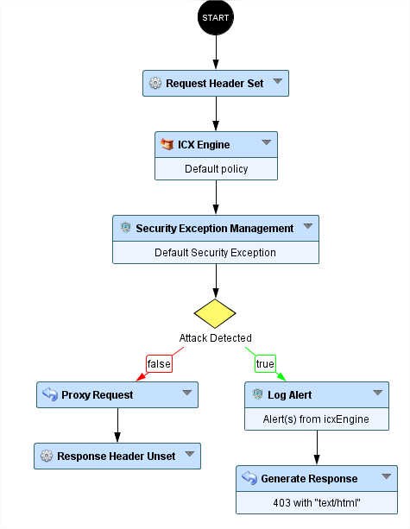
Workflow Basics
A workflow describes controls and manipulations made on requests and responses
The black ball provides request attributes used by followed bricks
3 types of bricks: native, decision, and subworkflows
Natives bricks: low level bricks
Decision: return true/false depending of condition(s)
Subworkflows: set of native bricks

Slide 10
Workflow Basics
Between the black ball and the brick “proxy request”, we are working on the request
After the brick “proxy request”, we are working on the response

Slide 11
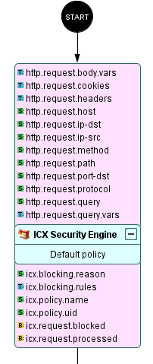
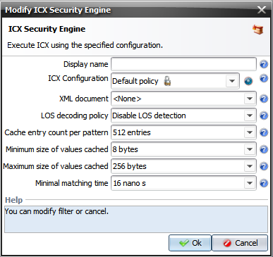
Workflow Basics
Required attributes
Each brick REQUIRES attributes, and some of them PROVIDE attributes
ICX Security Engine needs every attribute related to the request and provides ICX specific attributes
In general, brick needs “parameters” (double click)
Parameters
Provided attributes

Slide 12
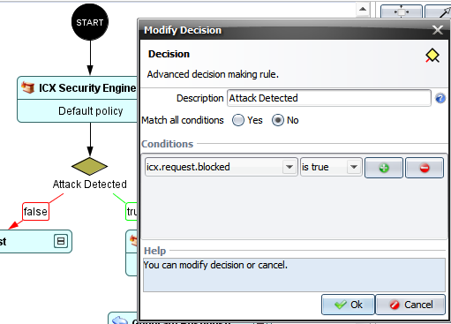
Workflow Basics
decision bricks will return true or false,
depending on the result of condition(s)
if attribute icx.request.blocked is true
then the decision brick will return true
conditions may be multiple
match all conditions ?
YES = “AND” will be put between each conditions
NO = “OR” will be put between each conditions

Slide 13
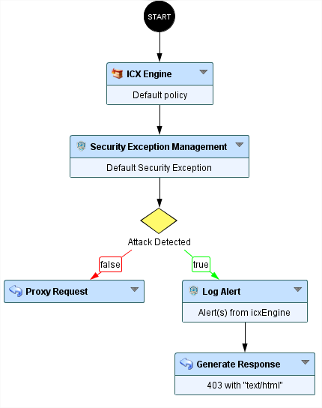
Workflow Basics
First let’s execute brick ICX Security Engine
Then let’s check if some attacks techniques are found in the request
If yes
Log an alert (security logs)
And then block the request (DA WAF will generate a 403 response)
If no
Proxy the request to the application
Implicitly, send the response to the client

Slide 14
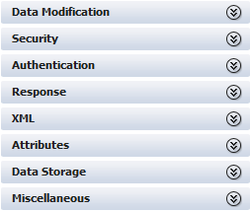
Workflow Basics
bricks provided in da waf are organized into categories
bricks are not only for security
Add/set/unset anything in the request
Add/set/unset anything in the response
Generate response (HTML/XML/..)
Dedicated XML bricks
Volatile data handling (attribute set ..)
Session data
Persistent data

Slide 15
Workflow Management

Slide 16
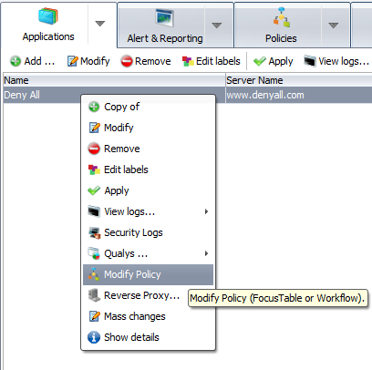

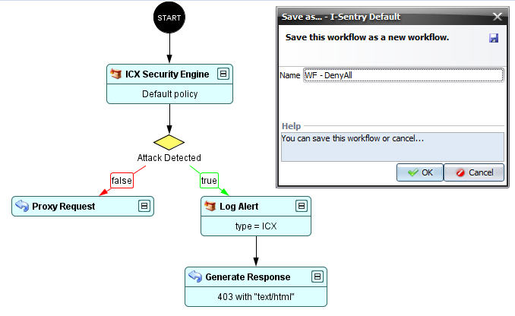
Workflow Management
Workflow creation (Recommended)
In the Applications tab, select your tunnel,
right click, and click on Modify Policy
When you are in the Policies tab,
click on Save as… so you can edit
the workflow
Name it

Slide 17
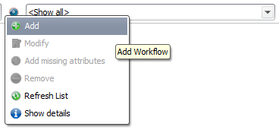
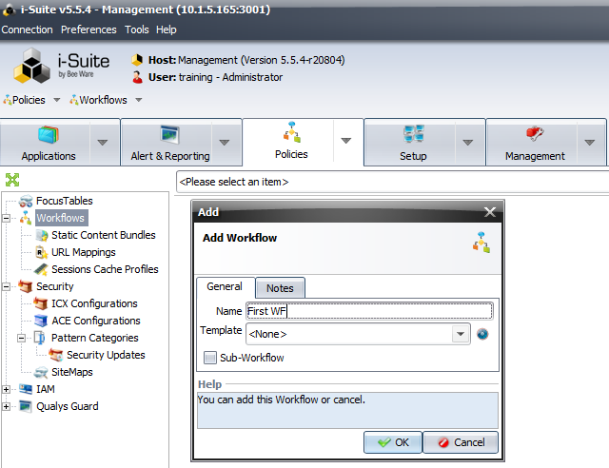
Workflow Management
Workflow creation (2)
In the Policies tab, Workflows subsection,
click on the small blue circle and then on Add
Name it
Let the Template field to <None> if you
want to build your workflow from the
start

Slide 18
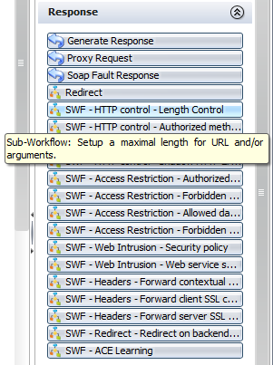
Sub-workflow Management
Can be called by a main workflow, or another sub-workflow
Serve to group a logical sequence of nodes together

Slide 19
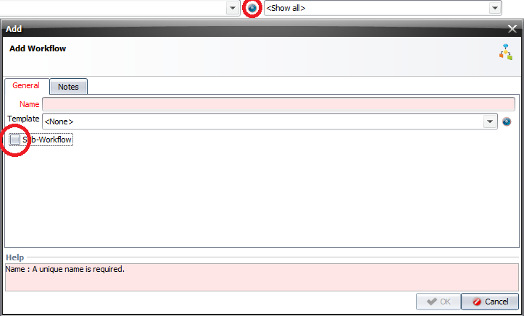
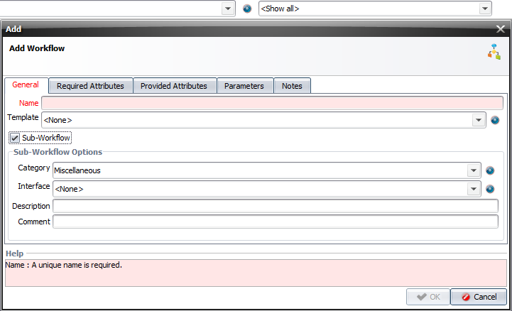
Sub-workflow Management
Sub-workflow
To create a new one, click on the blue
ball and then on Add
Check the Sub-Workflow button
Name it
Choose a category

Slide 20
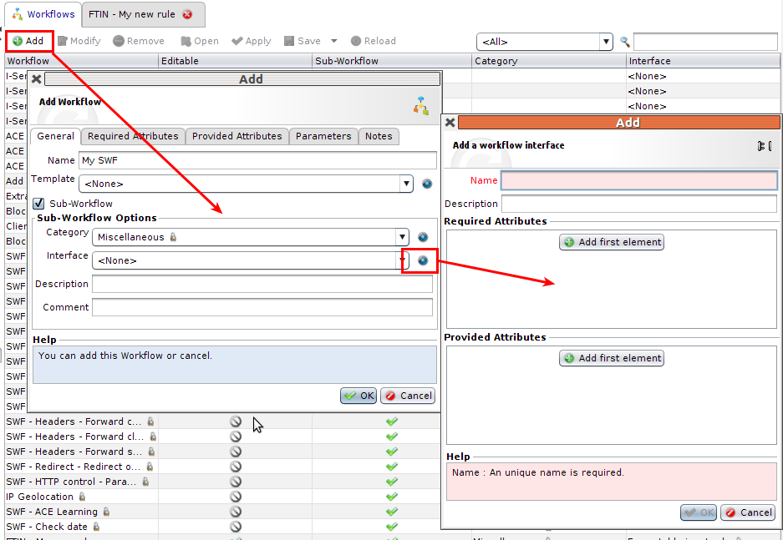
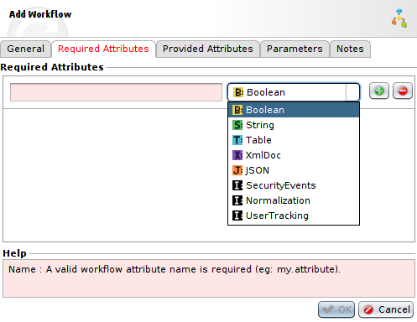
Sub-workflow Management
Interface

Slide 21
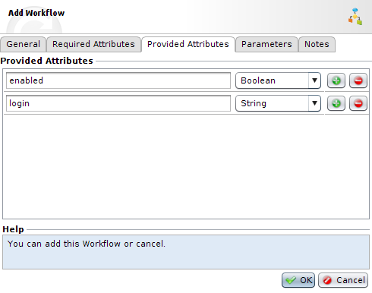
Sub-workflow Management
Required Attributes
Provided Attributes

Slide 22
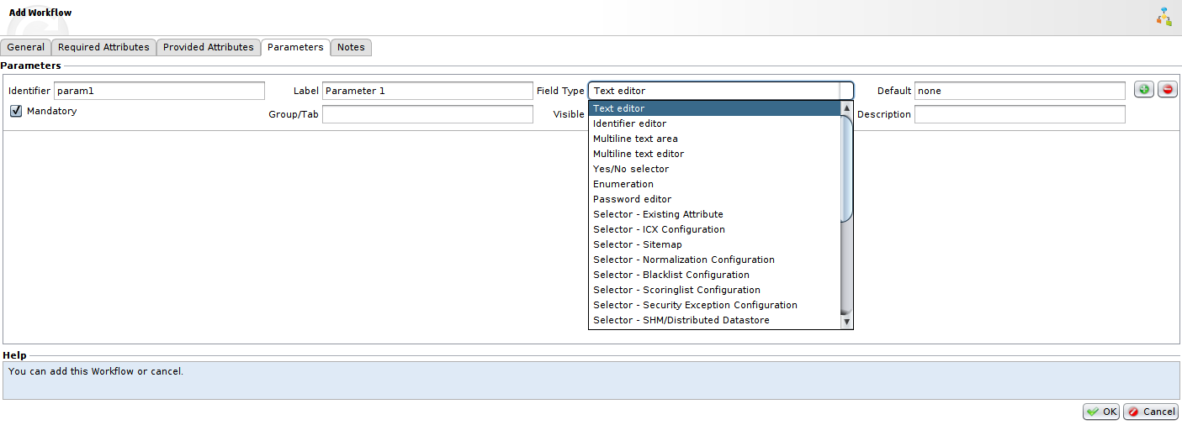
Workflow Management
Parameters

Slide 23
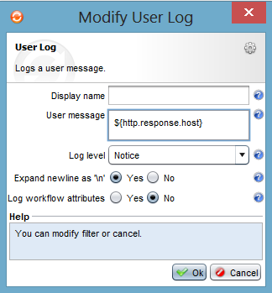
Workflow Management
Workflow debug
Possibility to use a User Log brick with
a custom message
Real time view in:
Management >> Log Management >>
YourTunnel >> Realtime View

Slide 24
Security Policy

Slide 25
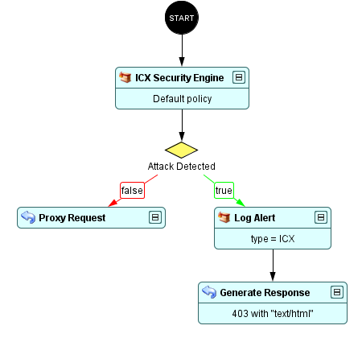
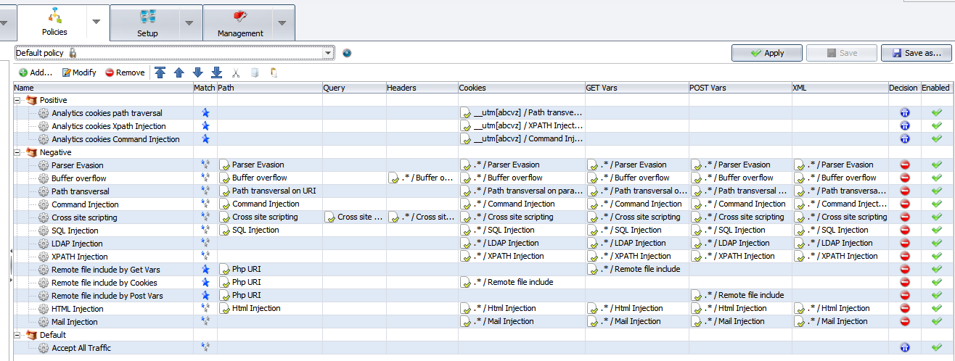
Security Policy

Slide 26
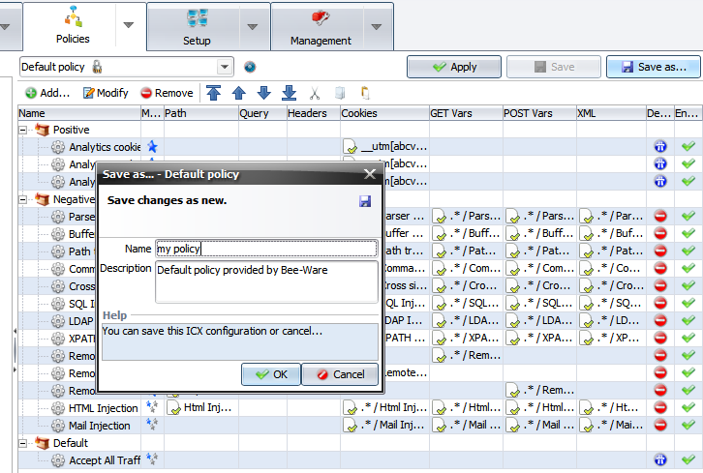
Security Policy
The default security policy is read only
You have to create one security policy to be able to use the “Resolve” magic button

Slide 27
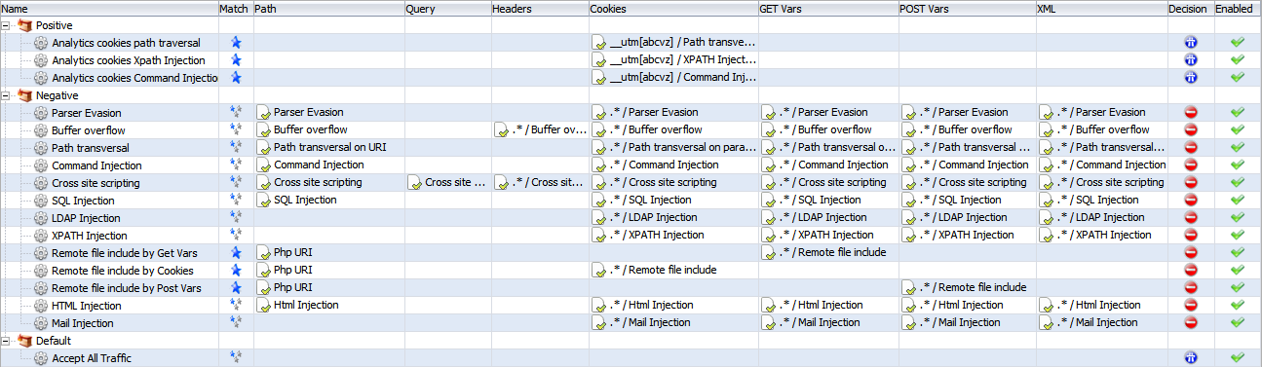
Security Policy
Attack techniques are checked in every part of the request

Slide 28
Security Policy
A request can be blocked for many reasons

Slide 29
Security Policy
The final decision depend of “accept” decision

Slide 30
New ICX Installation
Open the administration interface and connect yourself to the management appliance
In "Policies" panel, "Security", select "Security Updates"
Use the "Upload" button to upload the security update. The update will be directly installed and set as default
Warning: Default-policy and Default-policy (Strict) will be automatically updated. All others ICX policies have to be updated manually.

Slide 31
Policy update procedure
Select "ICX Configurations" then open the ICX policy to update DenyAll recommends to "Save as" the ICX policy first before applying this update.
Click on "Update". If the update is already applied, the update action will be disabled
Click on "Save" to validate changes
Repeat this operation for all ICX policies to upgrade
Apply changes using the "Apply" button

Slide 32
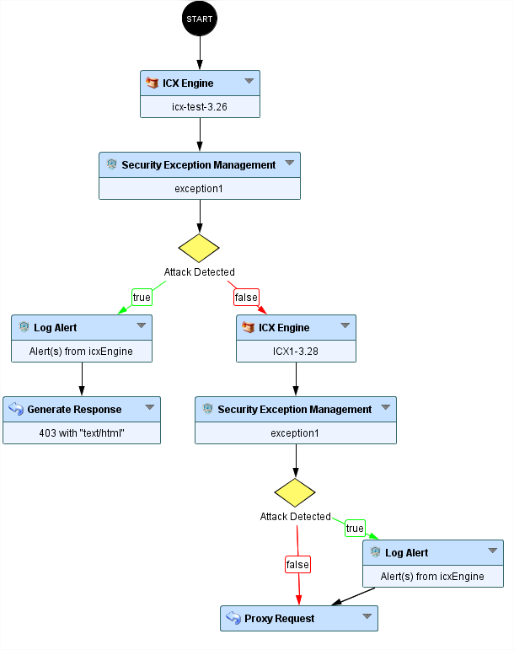
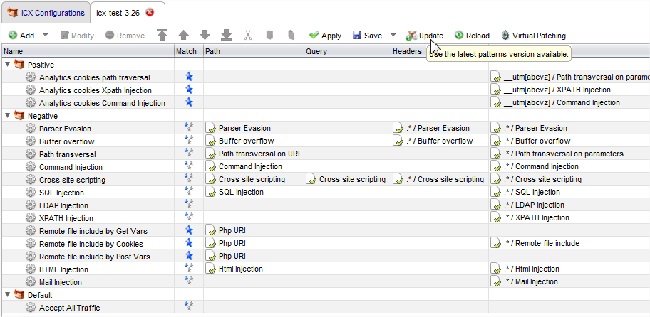
Policy update procedure - Production

Slide 33
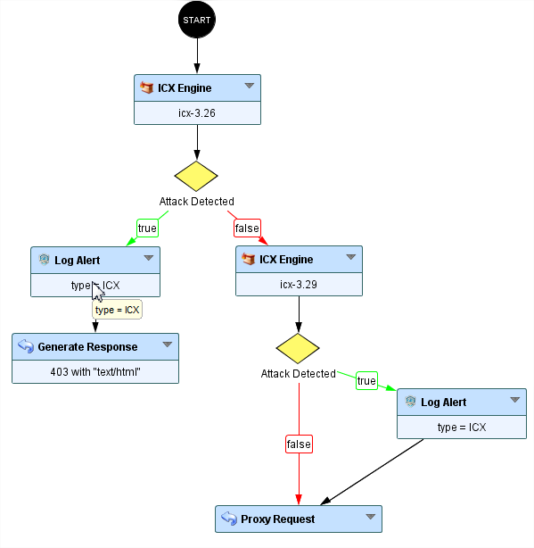
Challenge
ICX update
Download ICX pattern security update for LVS DAWAF v6
Install update using DSU file
Put only the new Rules in “no blocking” mode

Slide 34
Useful features

Slide 35
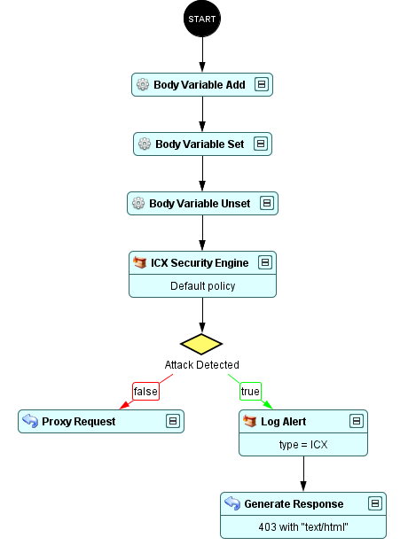
Useful features
How to add/modify/remove a body variable?
Data Modification category
Body Variable Add
Body Variable Set
Body Variable Unset
Need to be placed before the Proxy Request

Slide 36
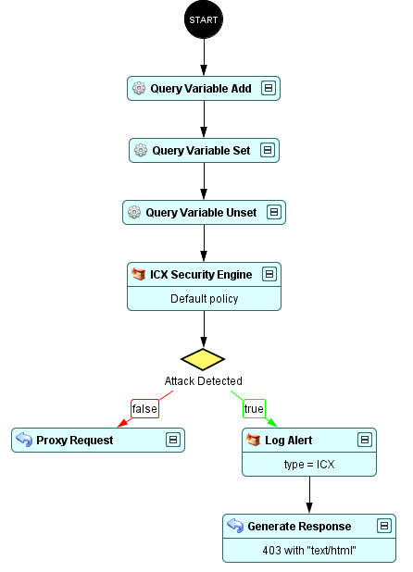
Useful features
How to add/modify/remove a query variable?
Data Modification category
Query Variable Add
Query Variable Set
Query Variable Unset
Need to be placed before the Proxy Request

Slide 37
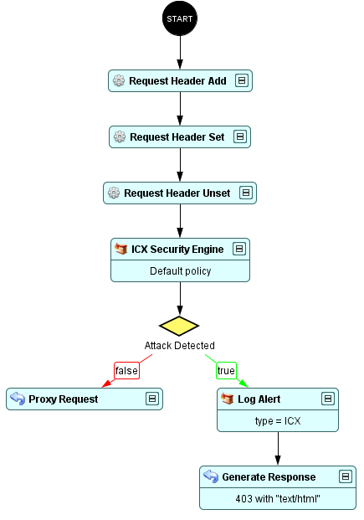
Useful features
How to add/modify/remove a request header?
Data Modification category
Request Header Add
Request Header Set
Request Header Unset
Need to be placed before the Proxy Request

Slide 38
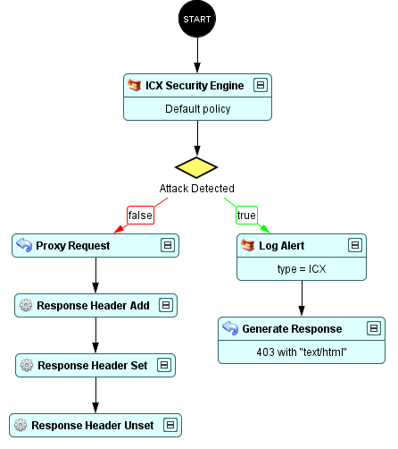
Useful features
How to add/modify/remove a response header?
Data Modification category
Response Header Add
Response Header Set
Response Header Unset
Need to be placed behind the Proxy Request

Slide 39
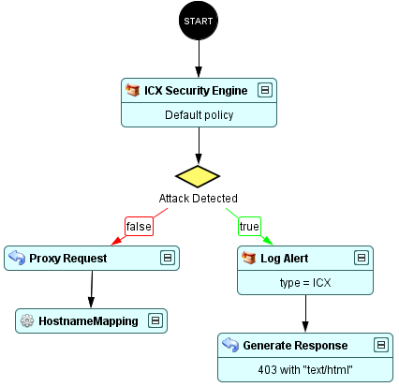
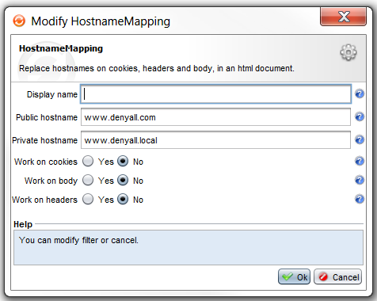
Useful features
How to modify the hostname in cookies, headers and body?
Data Modification category
HostnameMapping
Three options:
Work on cookies
Work on body
Work on headers

Slide 40
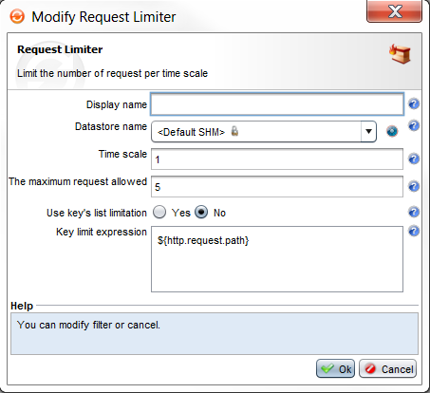
Useful features
How to mitigate the DDoS attacks?
Security category
Request Limiter brick
Allow to limit the access to a ressource
or an application per a time scale

Slide 41
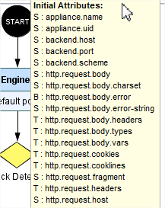
Useful features
Check & display Attribute
String
$ {attribut-name}
$ {http.request.ip-src}
Table
${table["key"]["value"]}
${http.request.headers['User-Agent’]}

Slide 42

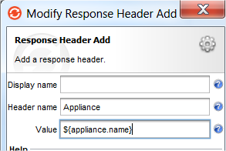
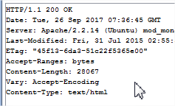
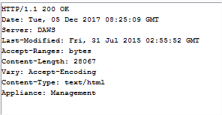
Challenge
1)
Add the Appliance name in response headers
Make the Server header as DAWS
Drop the Etag header

Slide 43
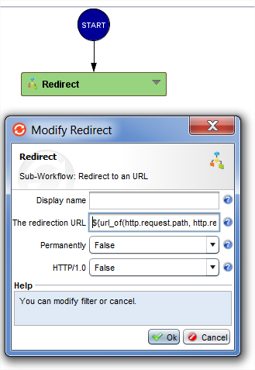
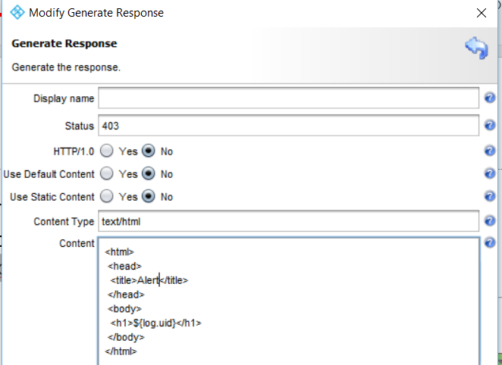
Challenge
2)
Automate the redirection from HTTP to HTTPS application
Option 1: https://app.denyall.local/
Option 2: ${url_of(http.request.path, http.request.query, http.request.host, "true")}
Use a customized error page
(test with https://x.x.x.x/?a=cmd.exe)
Add a « log.uid » in the error page

Slide 44
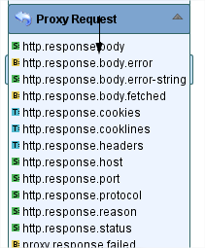
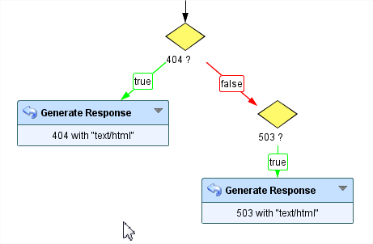
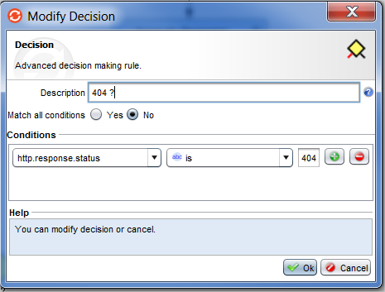
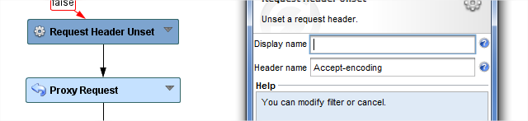
Challenge
3)
Create a sub-workflow:
Allowing interception of:
404 error pages
503 error pages
Can be completely disabled from the main workflow
Offering the possibility to disable only 404 error pages interception
Offering the possibility to disable only 503 error pages interception
Integrate it in the main workflow

Slide 45
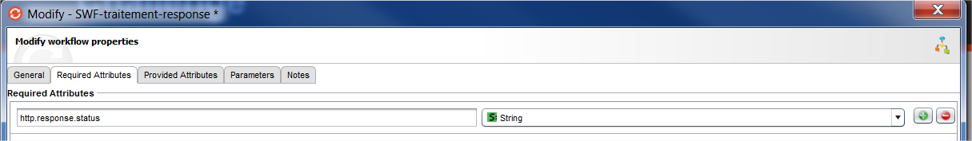
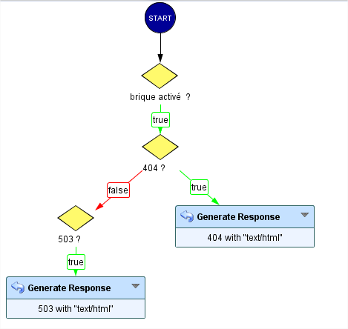
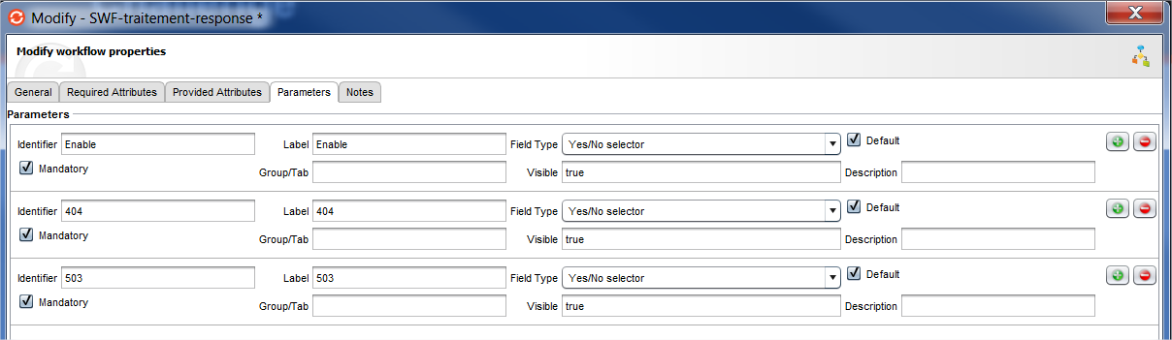
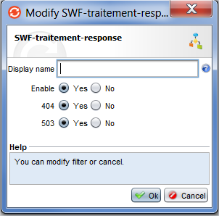
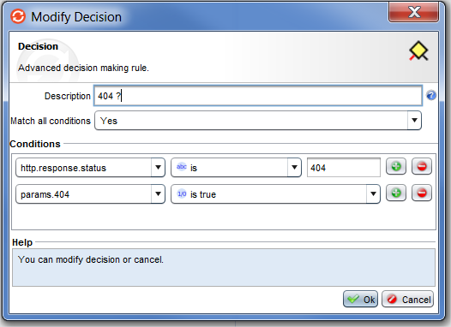
Challenge

Slide 46
Challenge
3)
Authorize access only to requests coming from local network
Deny access to /phpmyadmin/ from my IP address in two different ways:
First in the workflow
Second from the security policy ICX

Slide 47
Other Security Engines

Slide 48
IP Reputation
Powered by Webroot’s Threat Intelligence platform which monitors approx. 12 million dangerous IP addresses
IP reputation score computed by correlation of multiple, large data sources (+4B IPs, +27B URLs, +20B mobile apps)
Reputation score measures the overall risk associated with an IP source:
0-20: high risk
21-40: suspicious
41-60: moderate risk
61-80: low risk
81-100: trustworthy
Categorization helps understand if IP was used in various types of attacks
Web Attacks
Denial of Service
Anonymous Proxies
Botnets
Scanners
Windows Exploits
Spam sources
Phishing
Mobile Threats

Slide 49






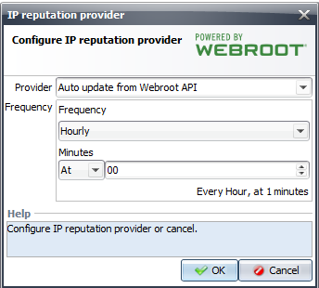
IP Reputation
DenyAll WAF Manager
BrightCloud API
Scheduled Task

Slide 50
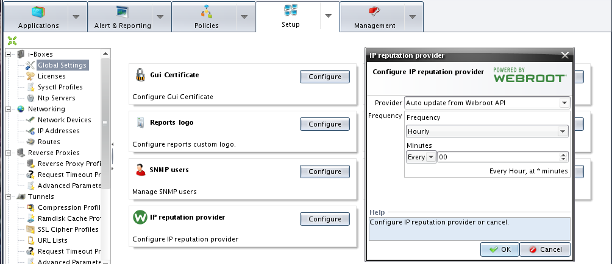
IP Reputation
Set up provider
By default online (requires connection via Webroot API)
Offline mode can be setup with manual upload of the DB file

Slide 51
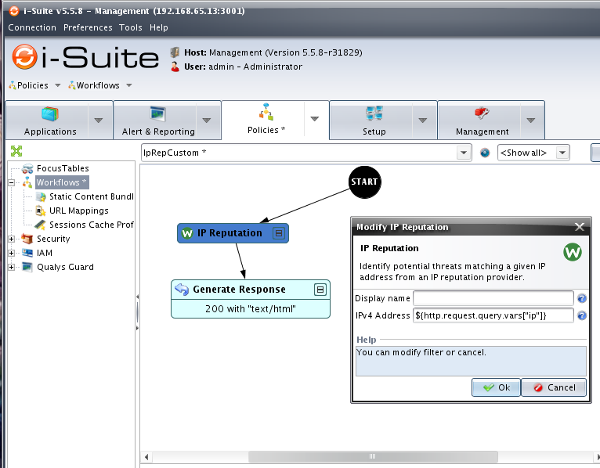

IP Reputation
Define policy
Match IP in reputation DB
Get threats & score

Slide 52




Challenge
Enable « IP Reputation »
Set up provider and Update database
Check « Event logs»
Add engine in https workflow

Slide 53


User Reputation Scoring

Slide 54
Sitemap & Whitelisting
Swagger/WADL…
Import
Sitemap
Validation
Request
Learning logs
Whitelist
generation
Logging

Slide 55

Sitemap & Whitelisting
Import/Export description file
Support for path & method
Parameter validation coming in 6.3

Slide 56

Sitemap & Whitelisting

Slide 57



Scoring list
Interpreting the content, like a web server does, to identify known and unknown (0day) attacks with great accuracy
How it works:
Weights assigned to each component
Blocking when threshold reached
Tested for 2 years, excellent accuracy
No updates, no learning, customizable
WAF Policy
Scoring
List
/?id=1;select+1&id=2,3+from+users+where+id=1--‘or /* comment */ 1=1 –
0,2
+
0,2
+
0,2
+
0,3
+
0,3
=
1,2

Slide 58

Normalization
Mitigate evasion attacks using encoded payloads
Base64
HTML
Different types of hexadecimal encodings

Slide 59


ICX / Blacklist / Scoring list / Normalization combination

Slide 60



Exception

Slide 61



Challenge
Use SWF security engine instead of ICX
Enable only ICX and Scoring list

Slide 62
Authentication

Slide 63



WAM Perimeter Authentication Standalone
Authentication portal
HTTP Basic
HTTP Form
X509
OTP/SMS
Kerberos (intranet)
Third-party integration
LDAP
RADIUS
PostgreSQL
MySQL

Slide 64


Challenge
Enable authentication in https tunnel:
Authentication method : Form
Authentication Backend: Internal
Local user to be created

Slide 65
Questions ?

