Slide 1
DenyAll WAF
False Positive Management
Official Training 2018

Slide 2
Summary
Basic Concepts
False positive management
Challenge

Slide 3
Basic concepts

Slide 4
Basic Concepts
What is a false positive?
  Detection of a request abnormally assessed as being dangerous
    Blocking of all requests bearing the misinterpreted sign
How to recognize a false positive?
  Determining if the use of the application is normal or malicious
    Confusion between a normal element and an attack pattern
    Configuration poorly suited to a detection method using a blacklist

Slide 5
False positive resolution

Slide 6
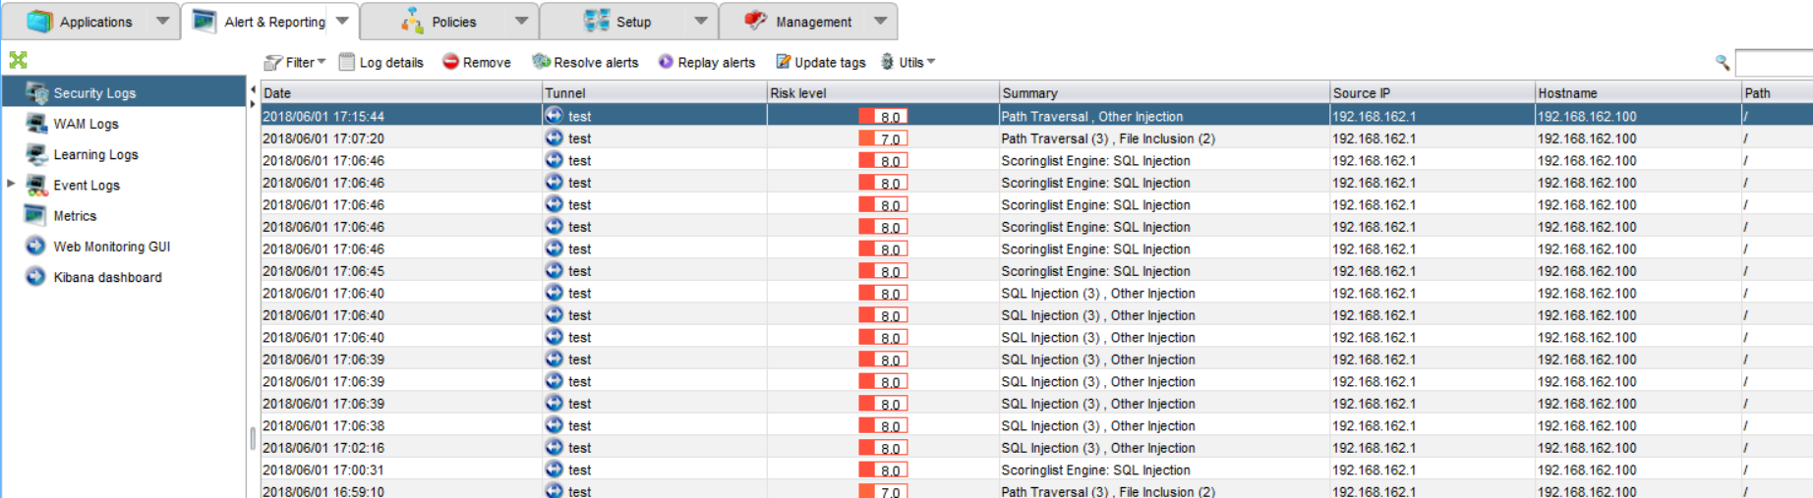
False positive management
Security logs
  In the Alert & Reporting tab, Security Logs tab, you can see the blocked requests

Slide 7
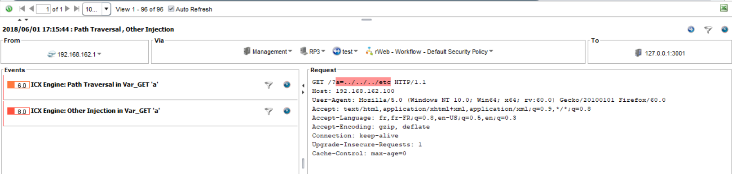
False positive management
Security logs details
  Double click on log line, the
  lower part of the panel appears showing:
    The reason for the alert
    The part of the request that met
    The conditions for the alert in red

Slide 8
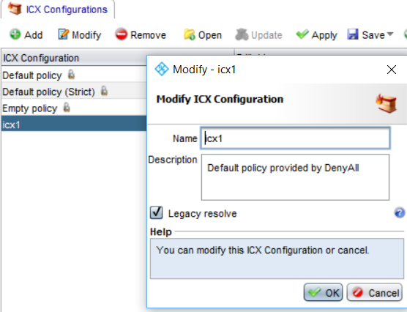
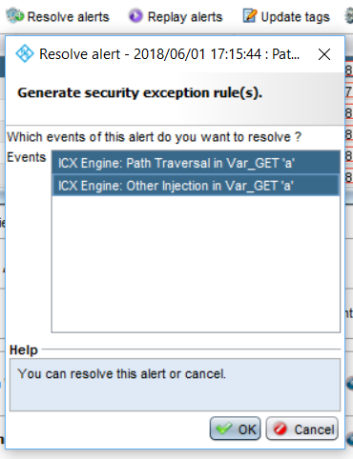
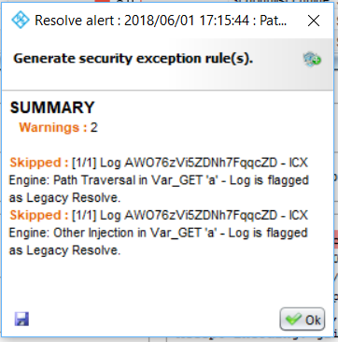
Automatic resolve with ICX engine

Slide 9
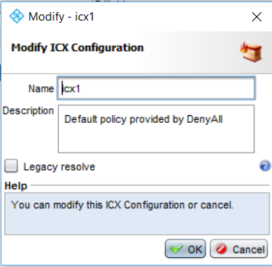
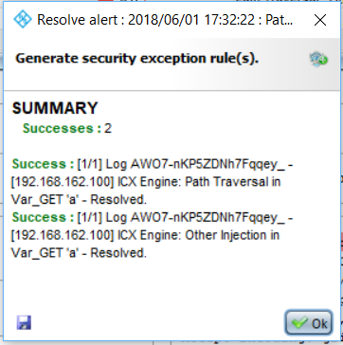
Automatic resolve with ICX engine

Slide 10
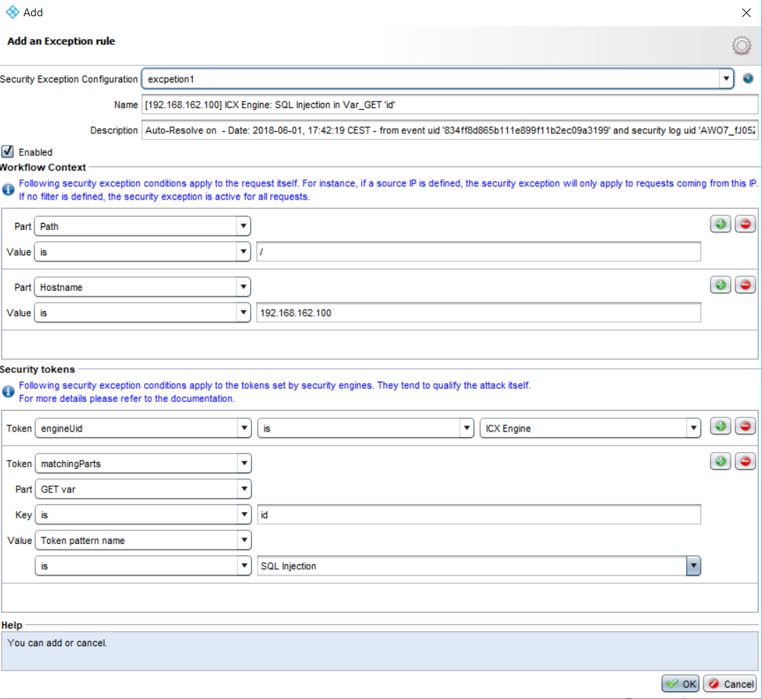
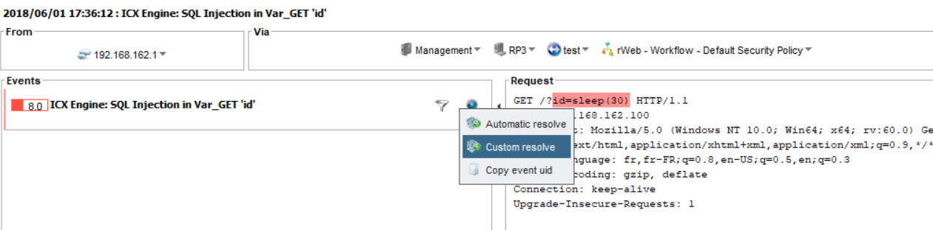
Custom resolve
Use case :
ICX in Legacy mode
generic exception
strict exception

Slide 11
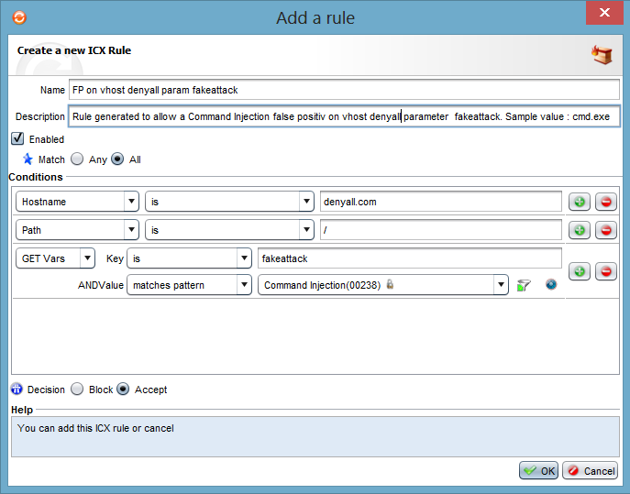
ICX False positive management (Legacy mode )
Resolving false positives
  Once the false positive determined:
    Choose the ICX configuration
    where the exception rule is to be
    Created (basic ICX policies can’t
    be modified)
    Resolve button
      Add rule panel shows up

Slide 12
ICX False positive management (Legacy mode )
Resolving false positives
  Three suggested exceptions:
    Hostname is host header value
    Path is /
    GET Vars (fakeattack)
    is Command Injection:
      GET Vars (fakeattack)
      no longer protected
      from Command Injection attacks

Slide 13
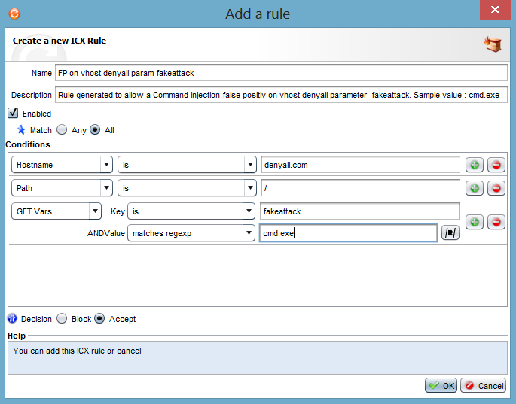
ICX False positive management (Legacy mode )
Resolving false positives
  1)
    Three suggested exceptions:
      Hostname is host header value
      Path is /
      GET Vars (fakeattack) matches
      regexp cmd.exe
        Reduces attack vector
        GET Vars (fakeattack)
        protected from cmd.exe
        Will only block a request
        when these three conditions
        are fulfilled

Slide 14
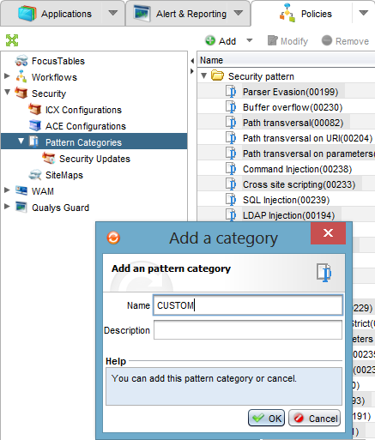
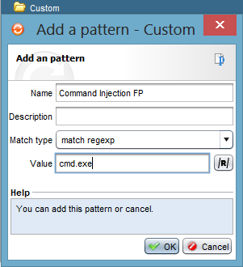
ICX False positive management (Legacy mode )
Resolving false positives
  2)
    Add a security pattern
      Add a category
      Add a pattern

Slide 15
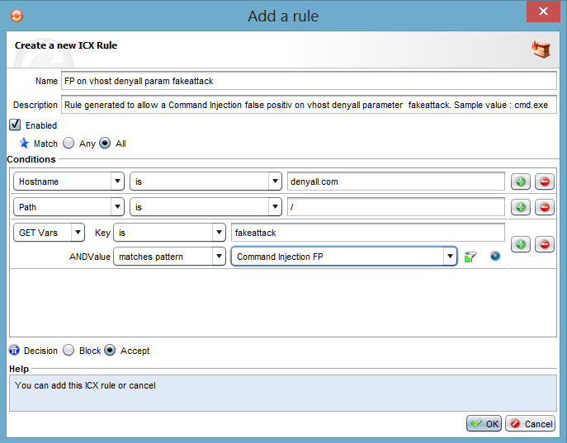
ICX False positive management (Legacy mode )
Resolving false positives
  2)
    Three suggested exceptions:
      Hostname is backend
      Path is /
      GET Vars matches the pattern
      newly created

Slide 16
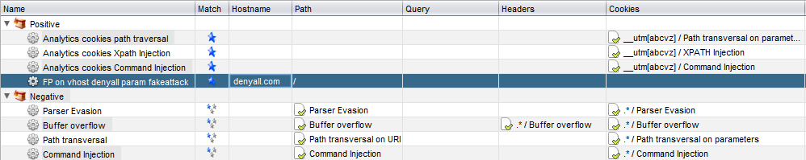
ICX False positive management (Legacy mode )
Checking that the false positive is taken into account
    False positive rule is added into the security policy rules

Slide 17
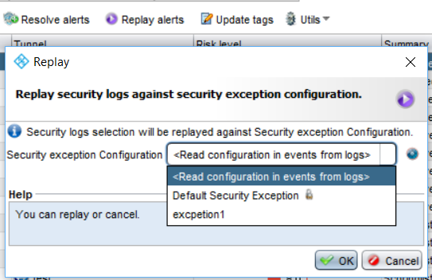
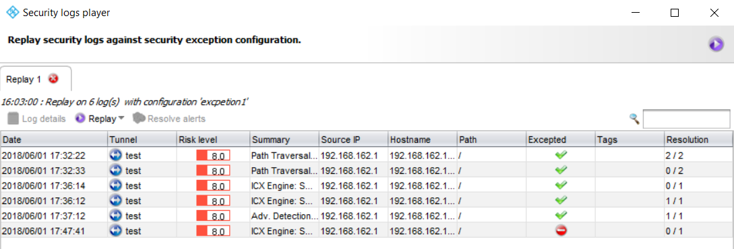
Replay alert log

Slide 18

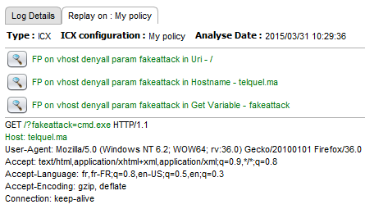
False positive management
Checking that the false positive is taken into account
    Click on the replay button
    The same request blocked before
    and written in red, is allowed and the three
    fulfilled conditions are in green

Slide 19
Challenge

Slide 20
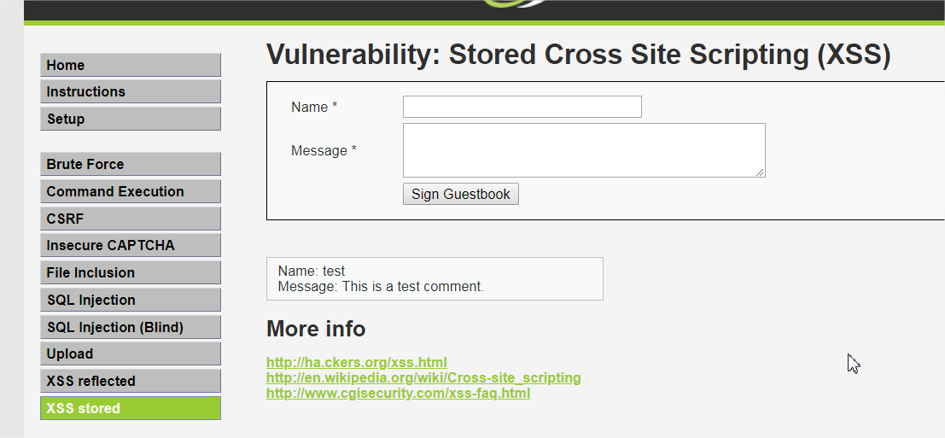
Challenge
  https://app.denyall.local/dvwa/
    Login: admin
    Password: admin
  Write these sentences in a form field, identify these false positives and resolve them:
    « cote d'or 24»
    « alert (toto)»

