Slide 1
DenyAll WAF
High availability & Load balancing
Official Training 2018

Slide 2
Summary
Basic Concepts
High Availability setup
Load Balancing setup

Slide 3
Basic concepts

Slide 4
Basic Concepts
What is a high availability ?
    Clustered system continuously operational for a desirably long length of time
What is a cluster ?
    Two or more computers (called nodes or members) working together or one taking over another to perform a task
What is a load balancer ?
    High availability mechanism that balances loads between the WAF and web backends

Slide 5
High-availability
Active-Passive

Slide 6
High Availability Setup
VRRP Cluster
    VRRP, the protocol for managing fault tolerance at the IP level
    Defined through the use of a Cluster ID (VRID)
    Members communicate via multicast packets using this ID
    Has virtual IP addresses created/deleted in response to events
    Only a single member has listing VIP address(es) at a moment
    In case of failure:
      Another member takes over and creates the VIP addresses
        The service can continue to operate

Slide 7
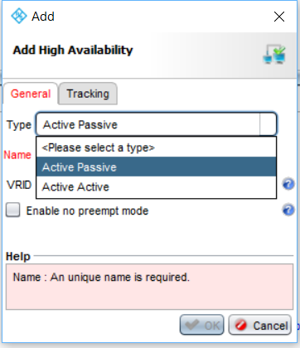
High Availability Setup
Creating a cluster
    In the Setup tab, High Availability section,
    click the Add button
    Name it
    Provide a unique digital identifier (Cluster ID)

Slide 8
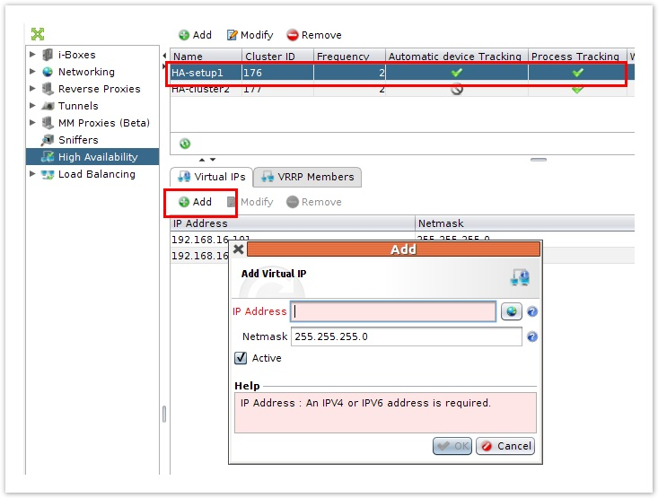
High Availability Setup
Creating virtual IPs
  Has to be associated with at least two members of the VRRP cluster
  Select the appropriate cluster
  Click the Add button

Slide 9
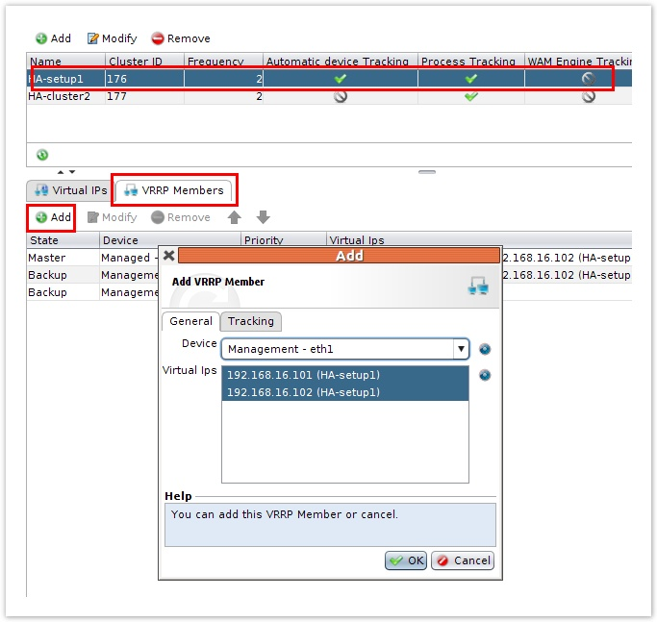
High Availability Setup
Creating VRRP Members
    Choose the interface
    The VIP will still be red (invalid) as long as it is not associated with at least two members
    Enable tracking in the Tracking tab, checks the interfaces for availability

Slide 10
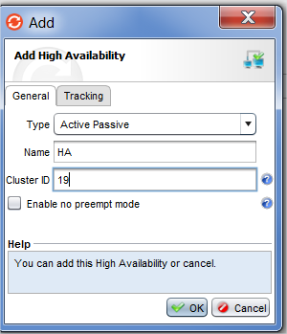
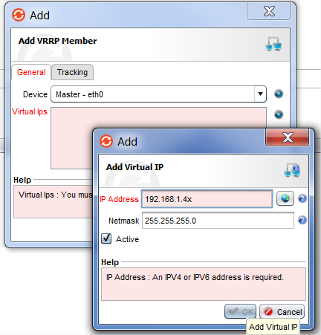
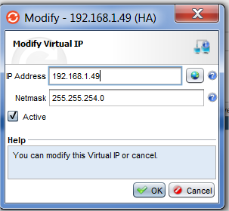
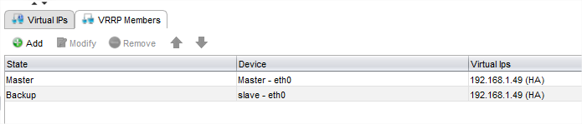
Challenge
Put in place High-availability configuration
  Add managed device
    Manager: 192.168.1.1x
    Managed : 192.168.1.2x
  Upgrade version of Managed
  Install License of Managed
  Creating virtual Ips: 192.168.1.4x
  Creating VRRP Members

Slide 11
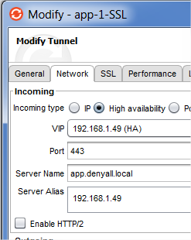
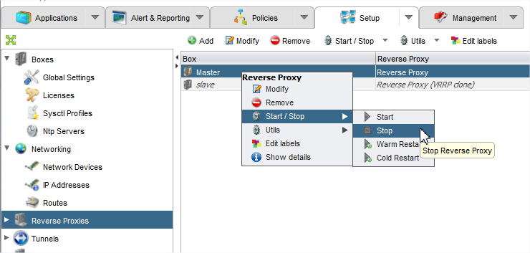
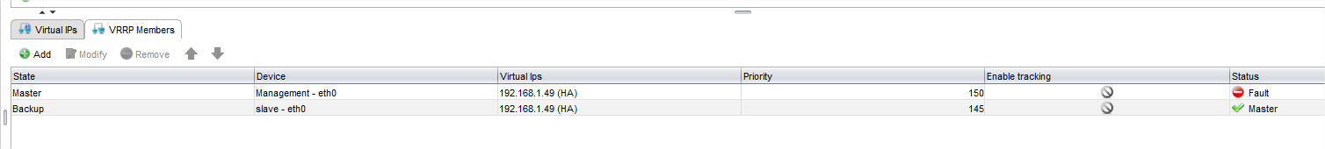
Challenge
  Change application configuration
  Test HA:
    Stop reverse proxy on Management

Slide 12
Load Balancing

Slide 13
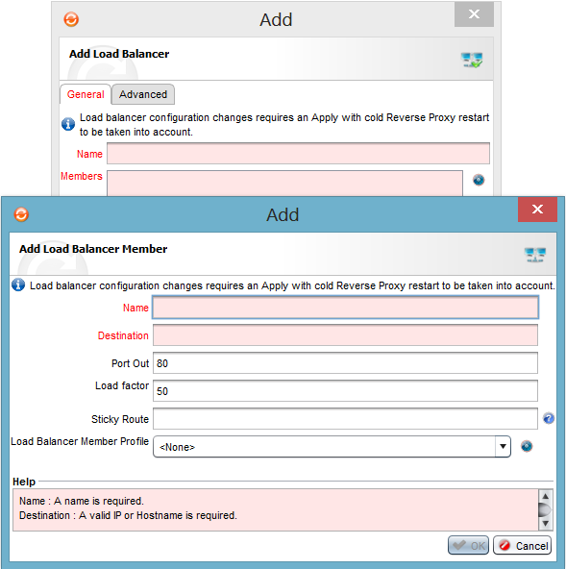
Load Balancing
Creating a load balancer
  In the Load Balancers section, click on Add button
  Choose a name
  Click on the blue button in front of Members field
  Name the member and provide a destination

Slide 14
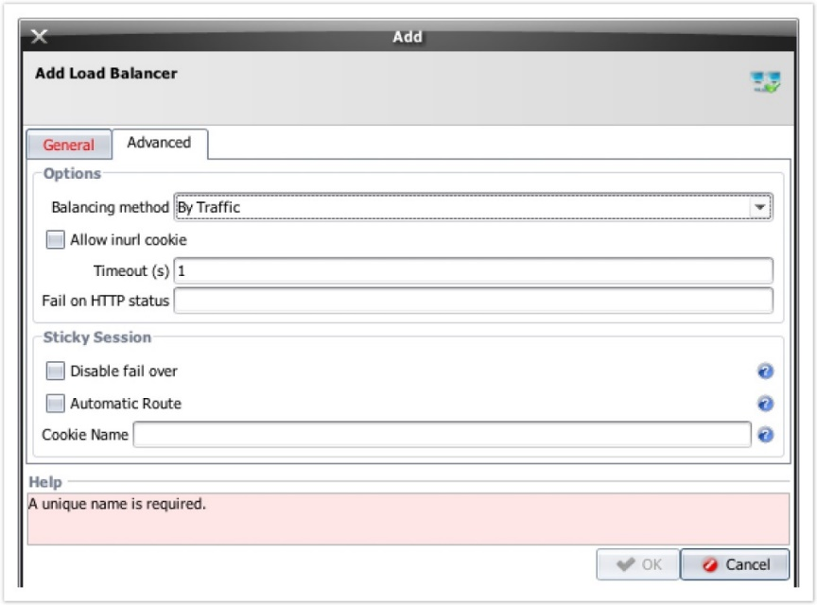
Load Balancing method
Creating a load balancer
  In the advanced tab, choose the balancing method:
    By Traffic: Distribution among the members of the cluster will be done as a function of the volume data
    By Request: Distribution is a function of the number of Requests
    By busyness: Distribution is according to the number of requests awaiting processing

Slide 15
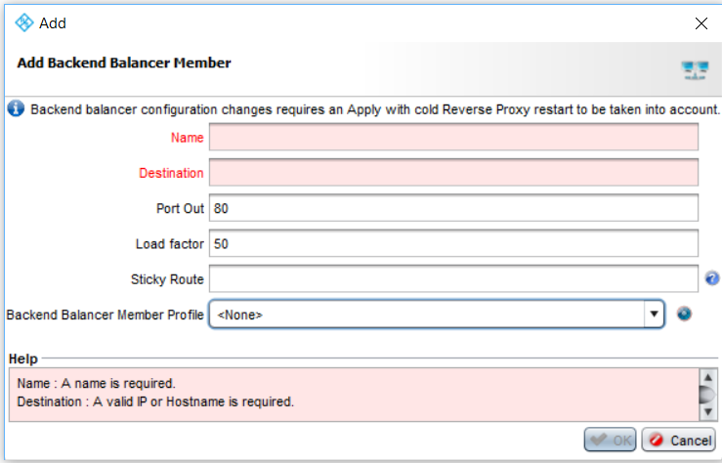
Load balancing member
Creating load balancer members
  Add button lets you:
    Choose the name of the member
    Assign an IP address
    Choose the outgoing port and the load factor (from 1 to 100%)
    Select the load Balancing profile managing configuration of:
      Keep Alive
      Time Out
      Retry

Slide 16
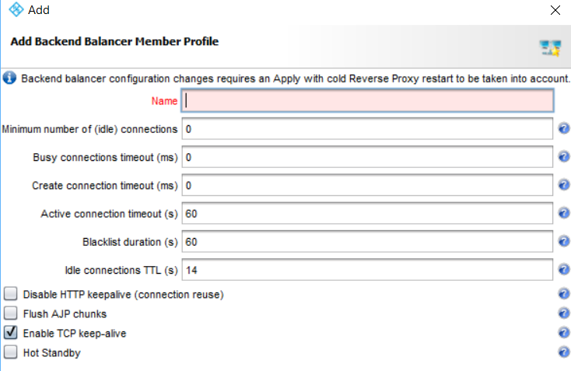
Load balancing member profile
Creating load balancer member profiles
    Minimum number of idle connections: Minimum number of active/maintained connections to the backend at any time
    Busy connections timeout: Maximum time to wait for an available connection (when the maximum number of connections to the member is reached)
    Create connection timeout: Maximum time to wait to establish a connection with the server
    Active connection timeout: Maximum time to wait to read or send the connection protocol data
    Blacklist duration: Time after which the servers that are in error status will again be used by load balancing

Slide 17
Load balancing
    Idle connections TTL: Maximum TTL of a connection to the server
    Disable HTTP Keep-Alive: Each connection will serve a single request and will be destroyed after use
    Flush AJP chunks: Apache Jserv Protocol chunks will be buffered as soon as they arrive
    Enable TCP Keep-Alive: TCP Keep-Alive will probe the idle connections periodically to detect timeouts
    Hot Standby: Simulates HA by downgrading the load balancing mode. The members are active but not called on. They are in case of failure of the server receiving the flow

Slide 18
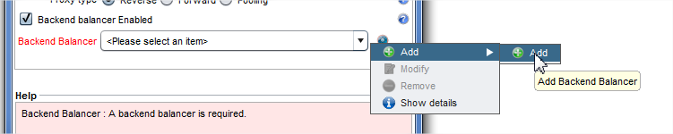
Challenge
Put in place load balancer configuration
  Creating a load balancer profile: By Request
  Creating a load balancer members:
    Backend server
      192.168.1.2
      192.168.1.3
  Change application configuration

Slide 19
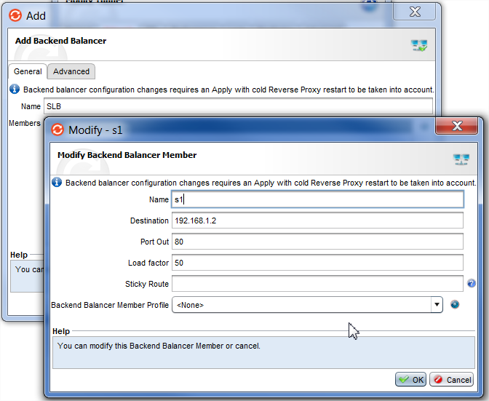
Challenge

Slide 20
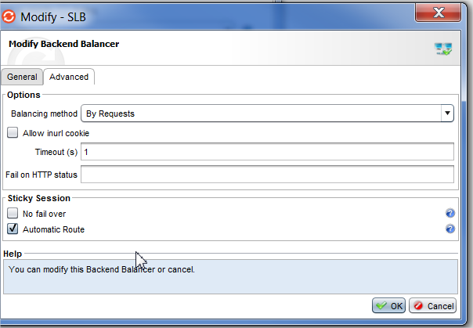
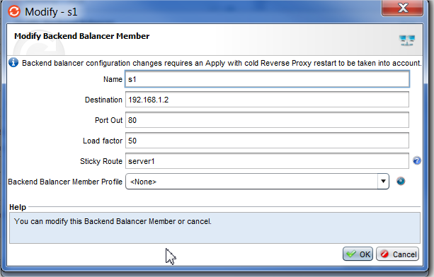
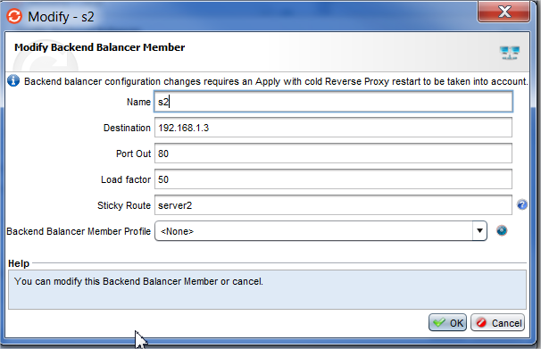
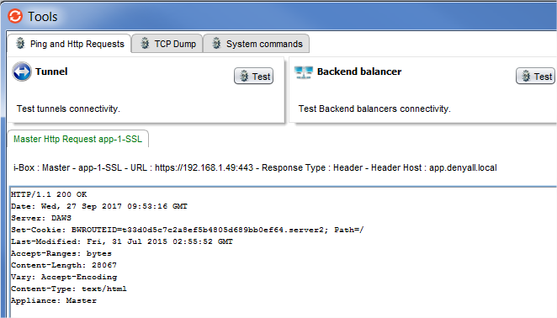
Challenge
Enable persistance

