Slide 1
DenyAll WAF Alerting & Monitoring
Official Training 2018

Slide 2
Logs

Slide 3
Log type definitions
Reverse Proxies
Error logs files
Tunnels
Error logs file
access logs
Files
Database
WAM
WAM logs database
Engine & Management & Apply
Event logs database

Slide 4
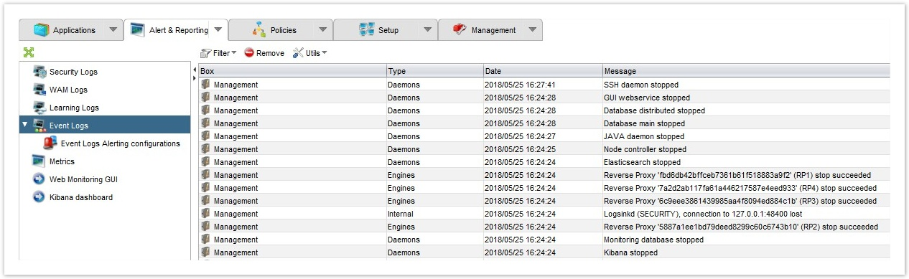
Event Logs
Display the history of changes in the status of monitoring
Each log includes:
Box
Type
Date
Message
Criticity

Slide 5
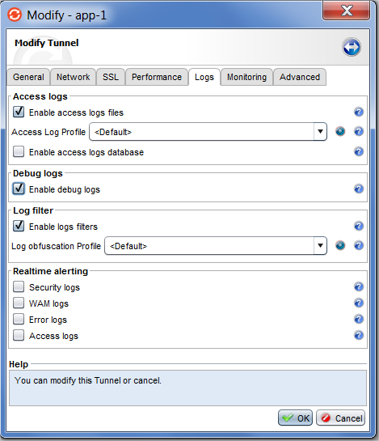
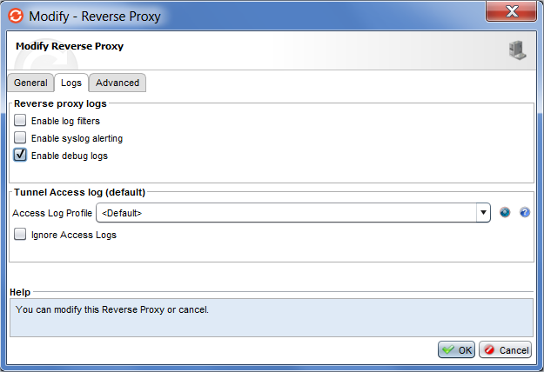
Debug logs
Tunnel / Reverse Proxy
Only for troubleshooting

Slide 6
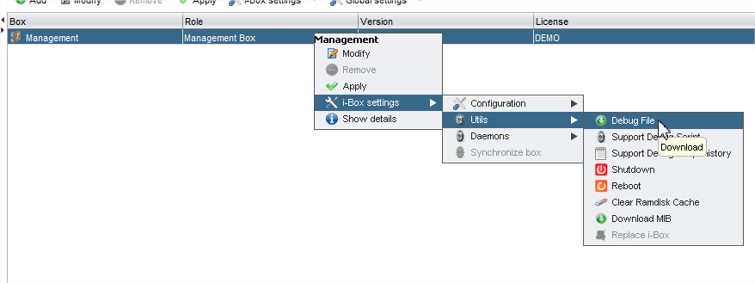
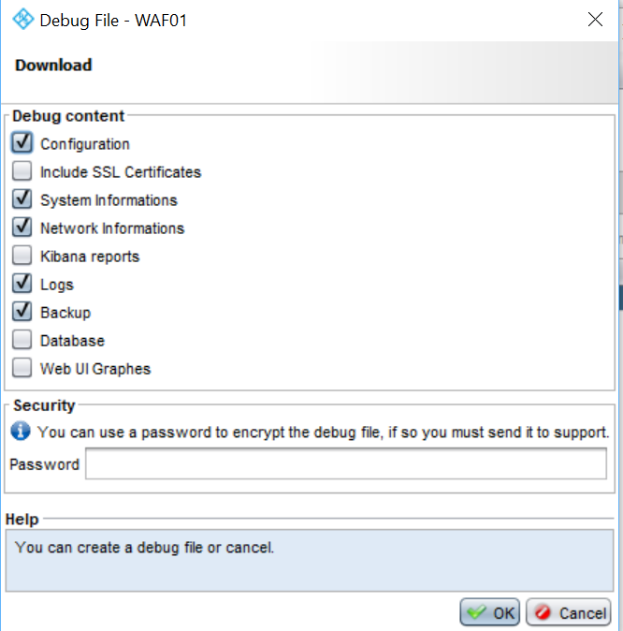
Generate debug logs

Slide 7
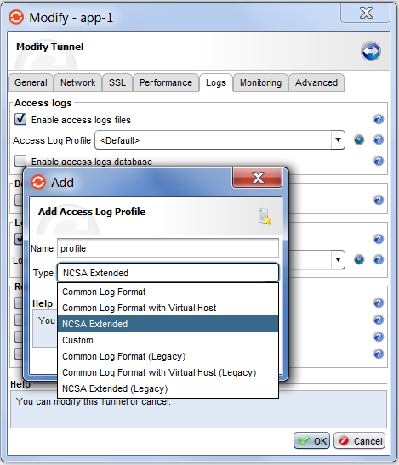
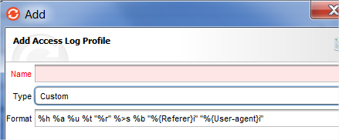
Access Logs files
Available logs format :
Common Log Format
Common Log Format with Virtual Host
NCSA Extended
Custom
Common Log Format (Legacy)
Common Log Format with Virtual Host (Legacy)
NCSA Extended (Legacy)

Slide 8
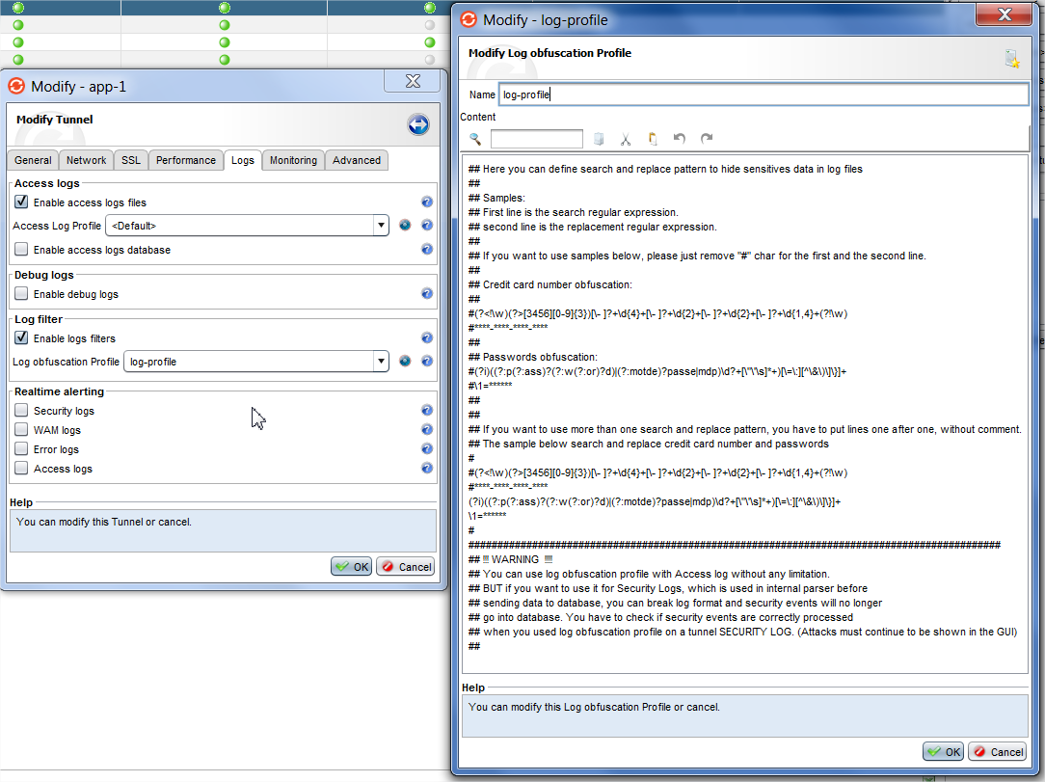
Hide sensitive information
Used to remove the specified data from logs

Slide 9
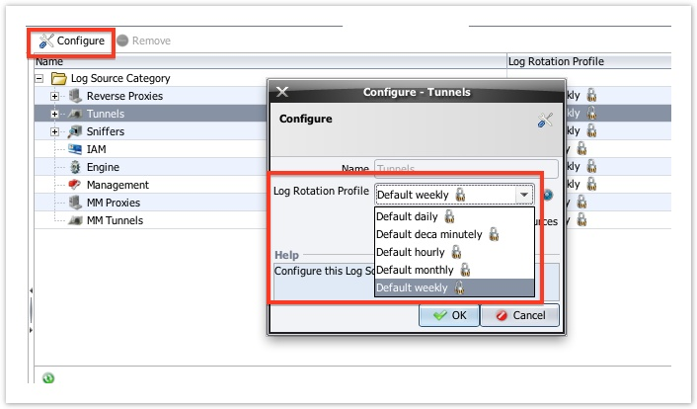
Log Rotation Profile
Manage logging functions
Possibility to select from the proposed list and configure with creation of log files

Slide 10
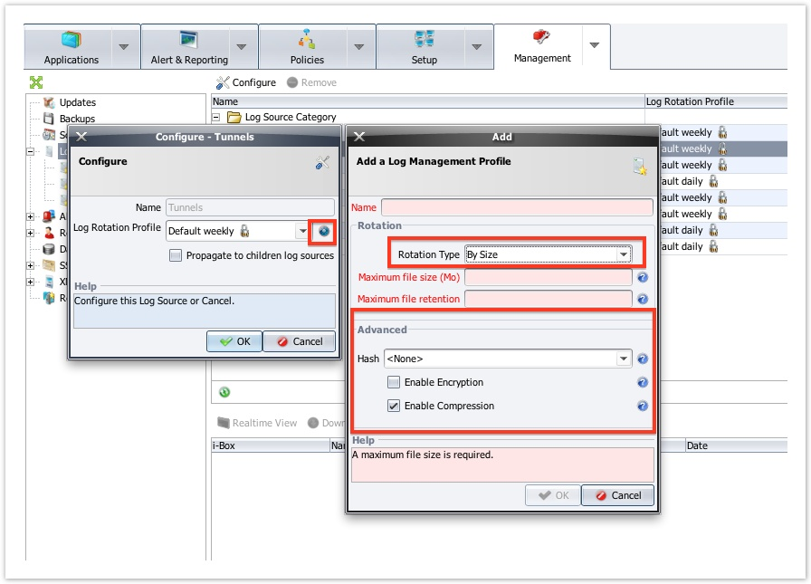
Log Rotation Profile
Manage logging functions
Possibility to create new Log Management Profiles
Example: Choose
rotation by size rather than
by date
Files can have a hash
and be encrypted and/or
compressed

Slide 11
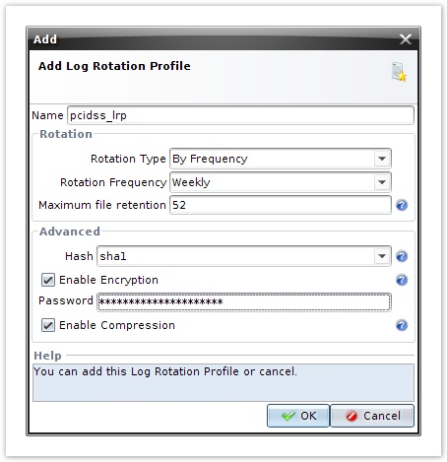
Log Rotation Profile
Manage logging functions
Possibility to add personalized log rotation profiles
Rotation Type: Criterion that will start rotation
Rotation Frequency: The maximum duration of a log file
before it is rotated
Maximum file retention: The number of files that are kept
Hash: Generates an MD5 or SHA1 hash of the file when it
is rotated
Enable Encryption: Encrypts the file when it is rotated
using the key configured in Password
Password: The encryption key
Enable Compression: Compresses the file in GZIP format

Slide 12
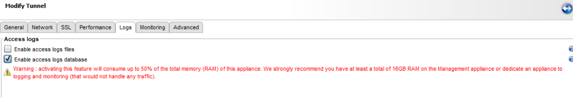
Access Logs database
will consume up to 50% of the total memory (RAM) of the Management appliance.
It can also be very consumer in CPU and disk space, depending of the traffic.
Need to use a dedicated Management appliance for the cluster configuration and log storage
Recommended values : +12 CPU cores and +16 GB memory

Slide 13
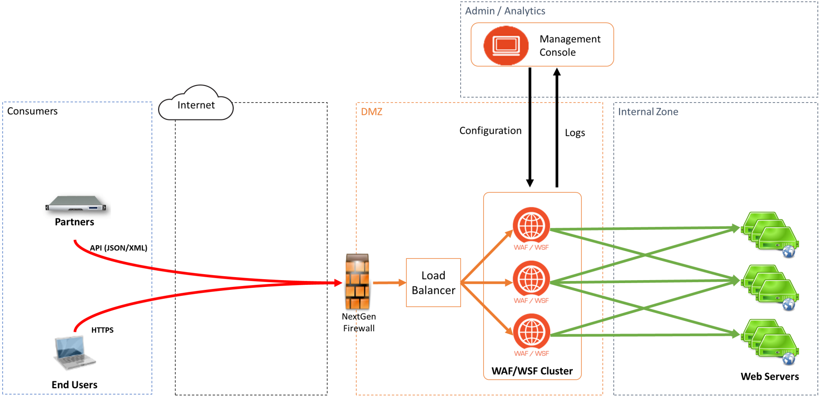
Architecture

Slide 14
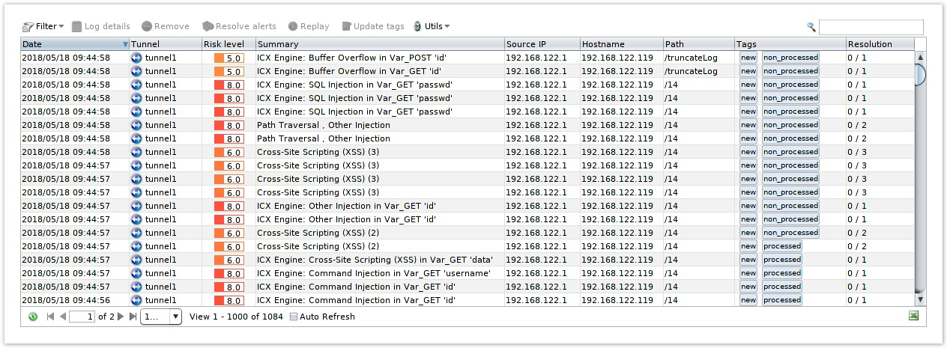
Security Logs
Shows the details of the attacks filtered by the i-Boxes
Displays in columns for each log line:
Date
Tunnel
Source
Risk level
Attack Family
Source-IP
Hostname
Path
TAG
Resolution

Slide 15
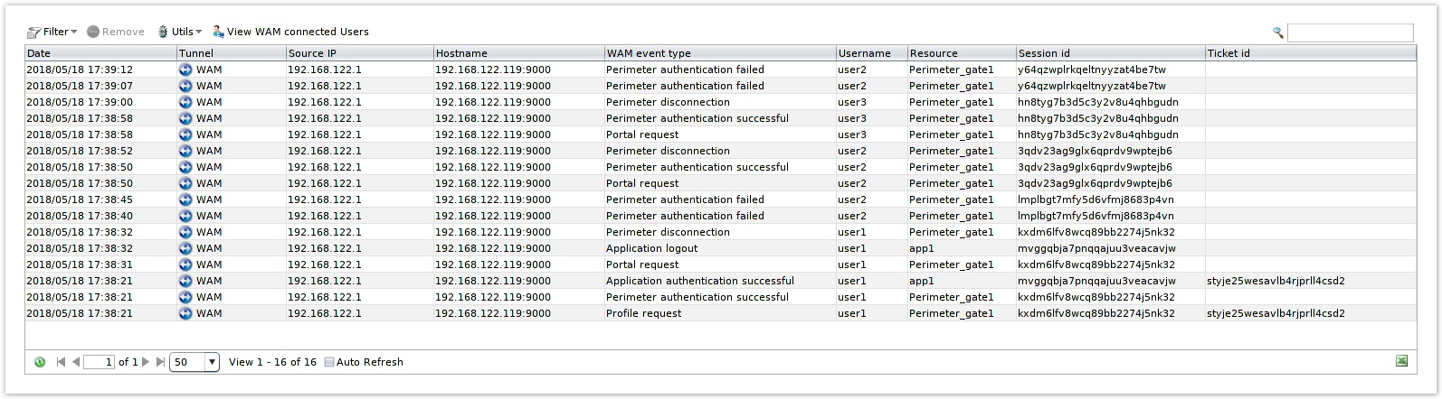
WAM Logs
Record WAM authentication events
Provide information on data:
Date
Tunnel
IP Source
Hostname
WAM Event type
Username
Resource
Session id
Ticket id

Slide 16
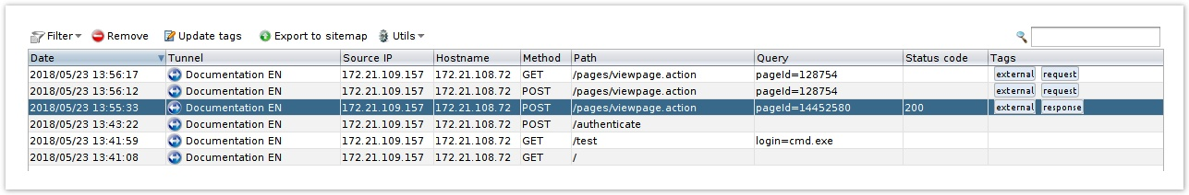
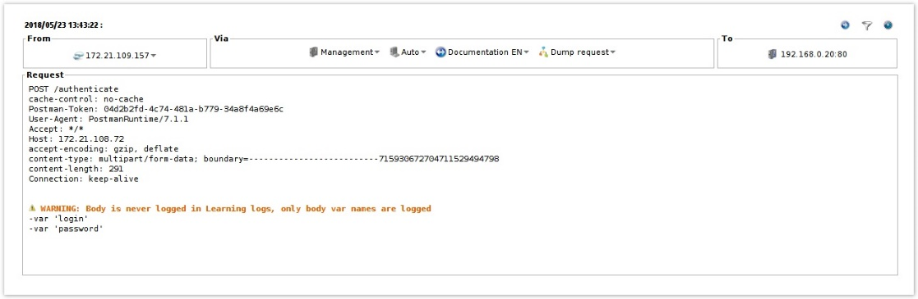
Learning Logs
To Build sitemap
Provide information on request :
Date
Tunnel
Source IP
Hostname
Method
Path
Query
Status code
Tags

Slide 17
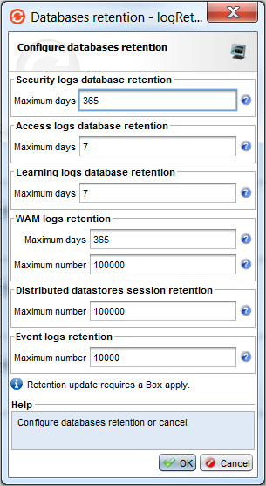
Database retention
Security logs database retention
Access logs database retention
Learning logs database retention
WAM logs retention:
Distributed datastores session retention
Event logs retention
Examples of database size related to the number of logs :
1 million access logs represent ~150 Mb of data
5 million access logs represent ~800 Mb of data
10 million access logs represent ~1600 Mb of data
1 million learning logs represent ~200 Mb of data
5 million learning logs represent ~1100 Mb of data
10 million learning logs represent ~2200 Mb of data

Slide 18
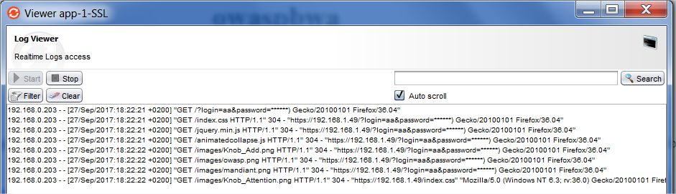
Challenge
Enable Access log files for all Tunnel
Create Obfuscation Profile
Test with specific request :
https://x.x.x.x/?login=aa&password=aaa
Change log rotation profile to daily for all applications

Slide 19
Challenge
Generate debug logs for https application
Enable access Logs database for https application

Slide 20
Alert & Reporting

Slide 21
Alerting
Create alerts for different types of logs
Send them by:
Syslog system
SNMP
Two alert systems available:
Log Alerting (only in 5.5 version)
Security log
WAM log
Event Logs Alerting

Slide 22
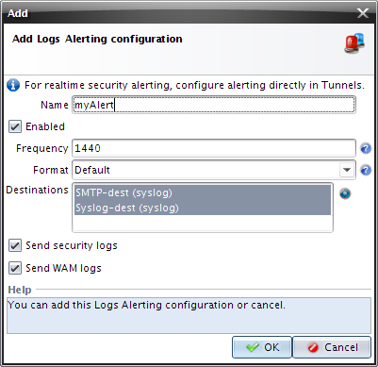
Log Alerting (only in version 5.5)
Log Alerting Configurations
Allow to send logs at regular intervals
Frequency: 1440 minutes by default
Format:
Simple
Default
Verbose (Can impact performances)
Destinations: Configurable in Alerting
Destination section

Slide 23
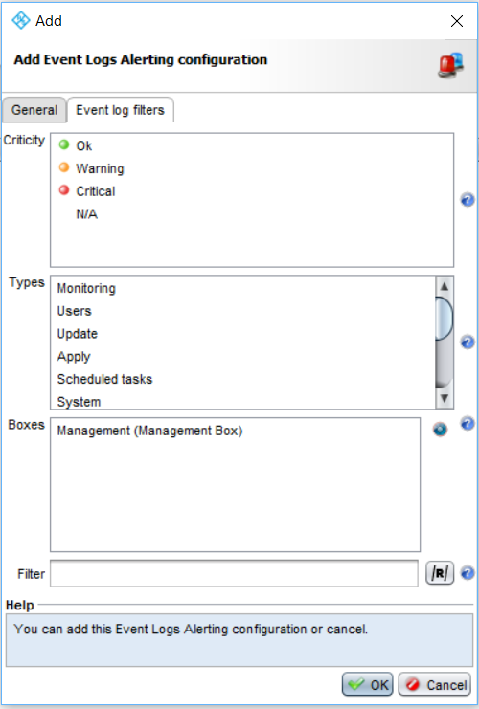
Event Logs Alerting
Event Log Alerting configurations
Used to send event logs

Slide 24
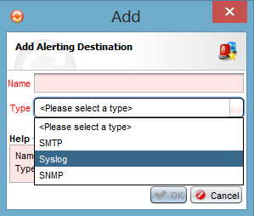
Alerting Destinations
SMTP
Syslog
SNMP

Slide 25
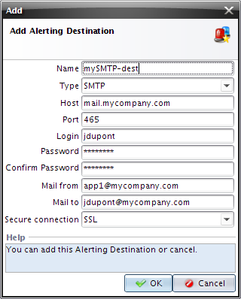
SMTP
SMTP destination
Port: By default 25 (no authentication)
465 (SSL)
Secure connection: SSL or TLS

Slide 26
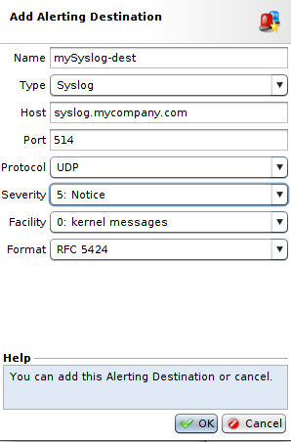
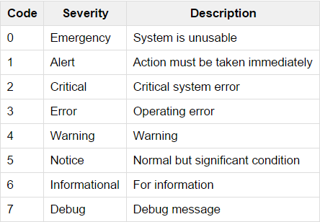
Syslog
Syslog destination
Port: By default 514 in UDP and 10514 in TCP

Slide 27
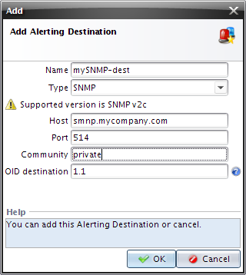
SNMP
SNMP destination
Community: SNMP request community
OID destination: Destination object
in the Management Information Base

Slide 28
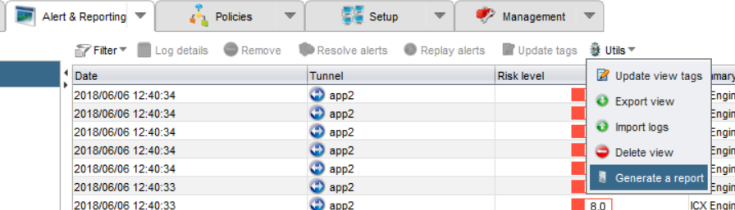
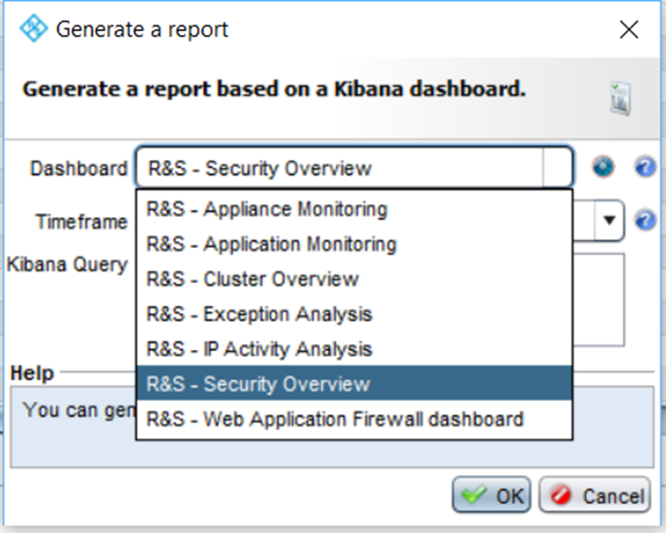
Report
List of default dashboards
R&S - Appliance Monitoring
R&S - Application Monitoring
R&S - Cluster Overview
R&S - Exception Analysis
R&S - IP Activity Analysis
R&S - Security Overview
R&S - Web Application Firewall Dashboard

Slide 29
Management

Slide 30
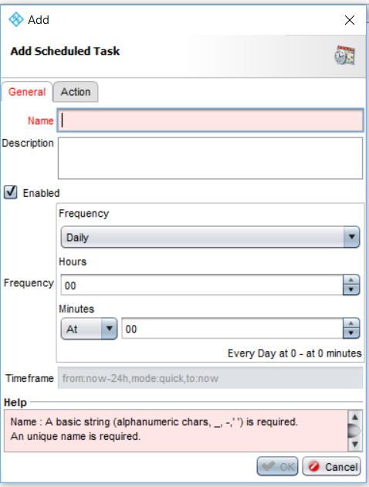
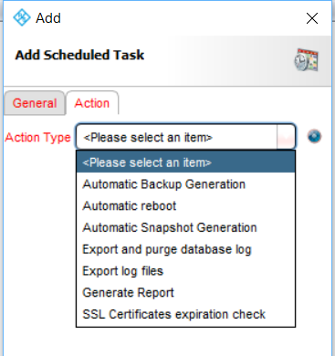
Scheduled Tasks
Automatic Backup generation
Automatic reboot
Automatic Snapshot Generation
Export and purge database log
Export log file
Generate Report
SSL Certificates expiration check

Slide 31
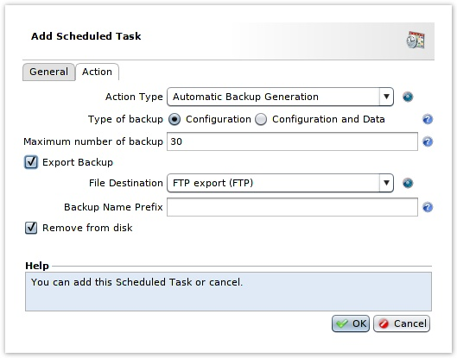
Scheduled Tasks
Automatic Backup Generation
Type of backup:
Configuration: Alone
Configuration and Data: Configuration with the internal data (WAM connected user, event logs, static content bundle, ...)

Slide 32
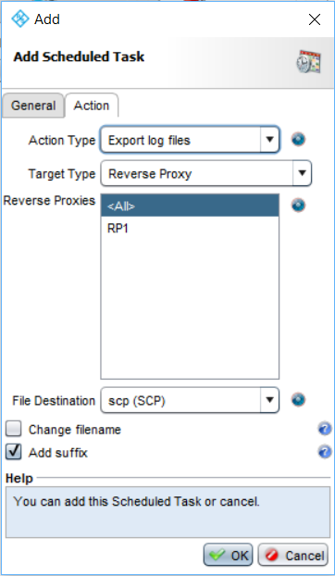
Scheduled Tasks
Exporting log files
Creating a task
Export log files
Destination
Files to be exported

Slide 33
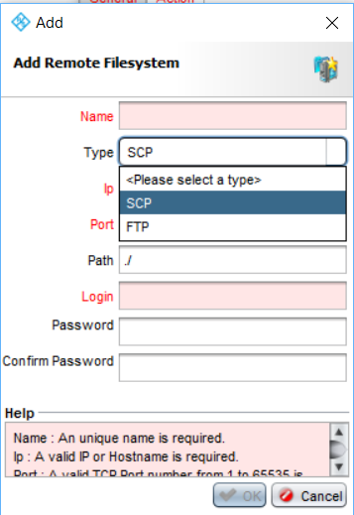
Scheduled Tasks
Remote Filesystem
Declaring remote storage
Action tab:
Click the blue button and choose Add
Select the type of access FTP or SCP
Enter the connection information

Slide 34
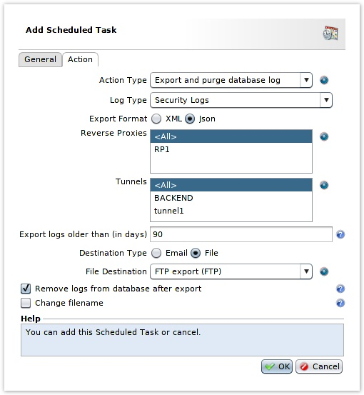
Scheduled Tasks
Export and purge database log
Security Logs
WAM Logs
Event logs

Slide 35
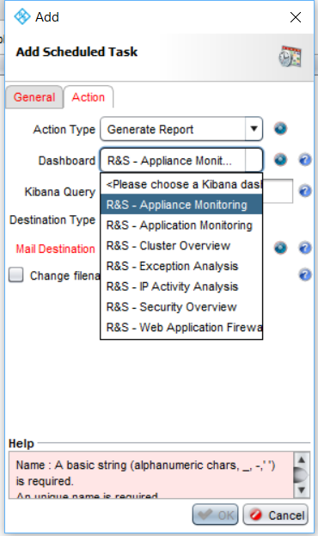
Scheduled Tasks
Generate Reports
Action tab, choose:
Generate Report
Report Type
Destination Type

Slide 36
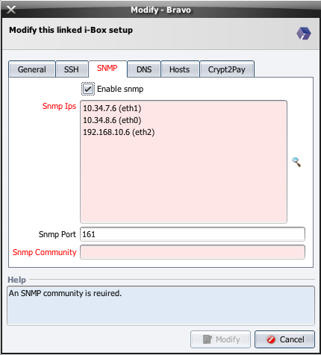
SNMP
Enabling SNMP supervision
Using the SNMP agent installed on the boxes
Versions supported:
SNMP v1
SNMP v2c

Slide 37
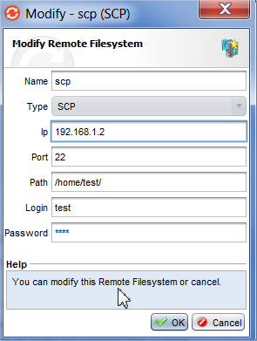
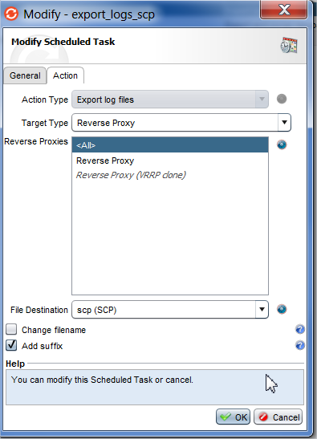
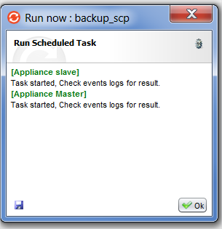
Challenge
Configure file destination server
SCP server=192.168.1.2
Login=test
Password=test
Schedule a daily export log files at 10 AM
Schedule a daily report generation on Access Logs at 10 AM
Schedule a daily backup generation & export at 10 AM

Slide 38
Monitoring

Slide 39
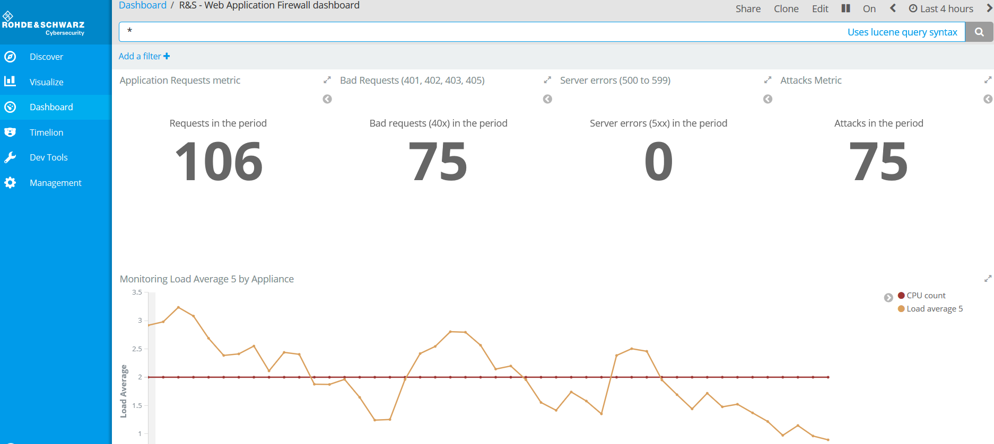
Kibana dashboard
Default URL: https://<managementIP>:3001/app/kibana

Slide 40
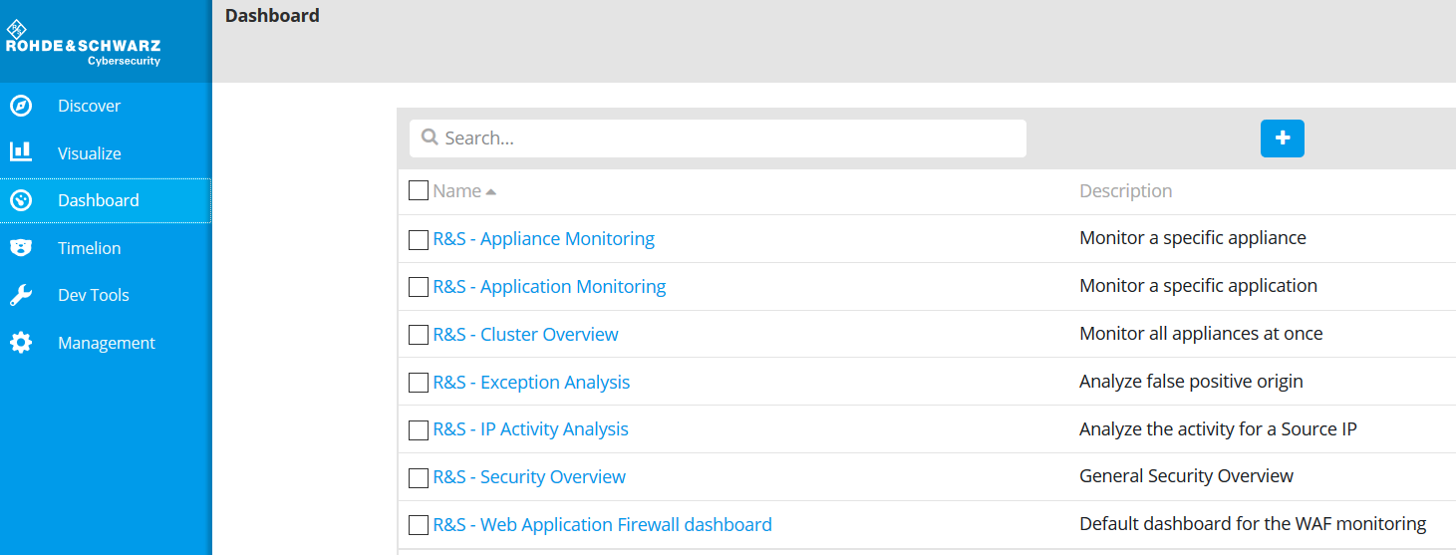
Kibana dashboard

Slide 41
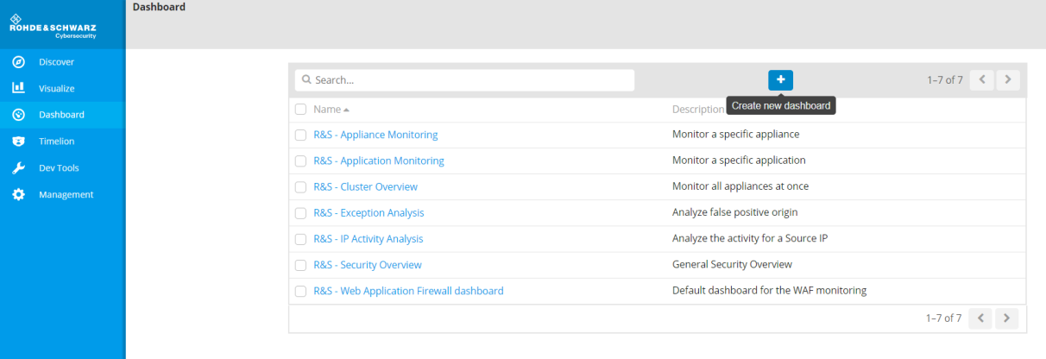
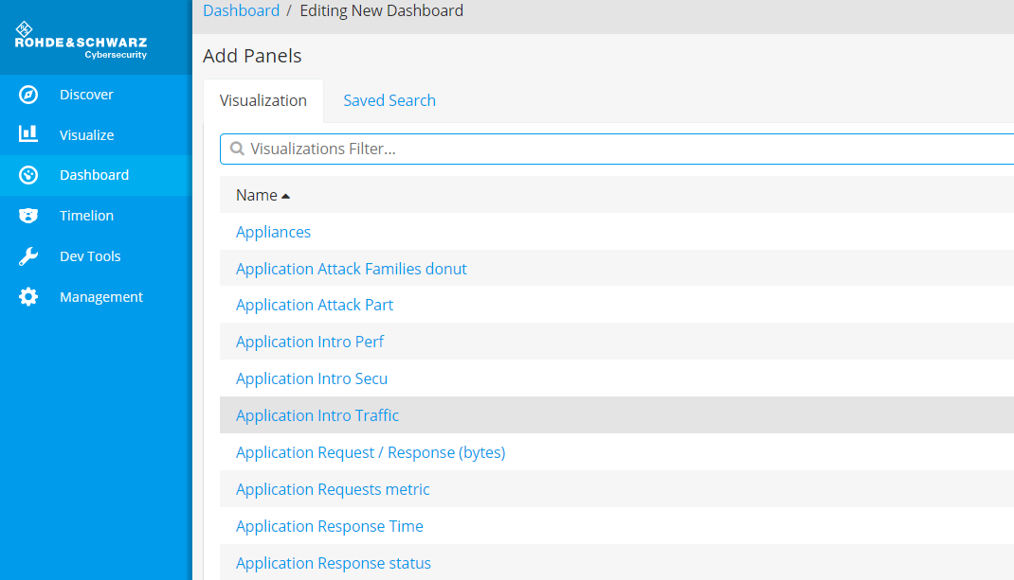
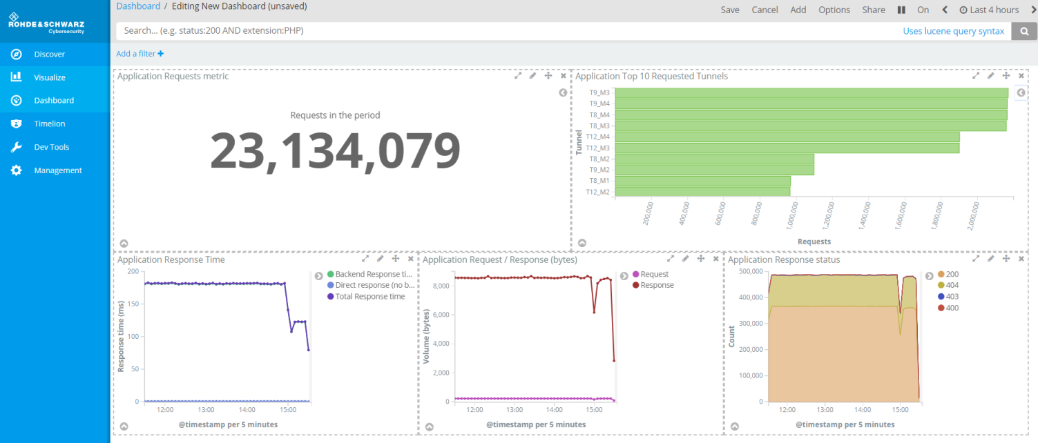
Create new dashboard (1/2)
Create new dashboard
Add the desired visualizations
Adjust the layout

Slide 42
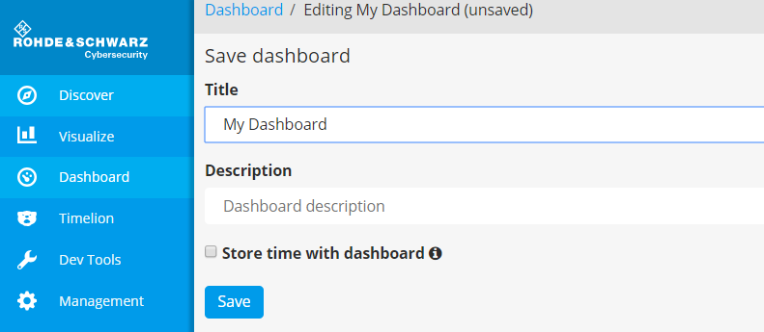
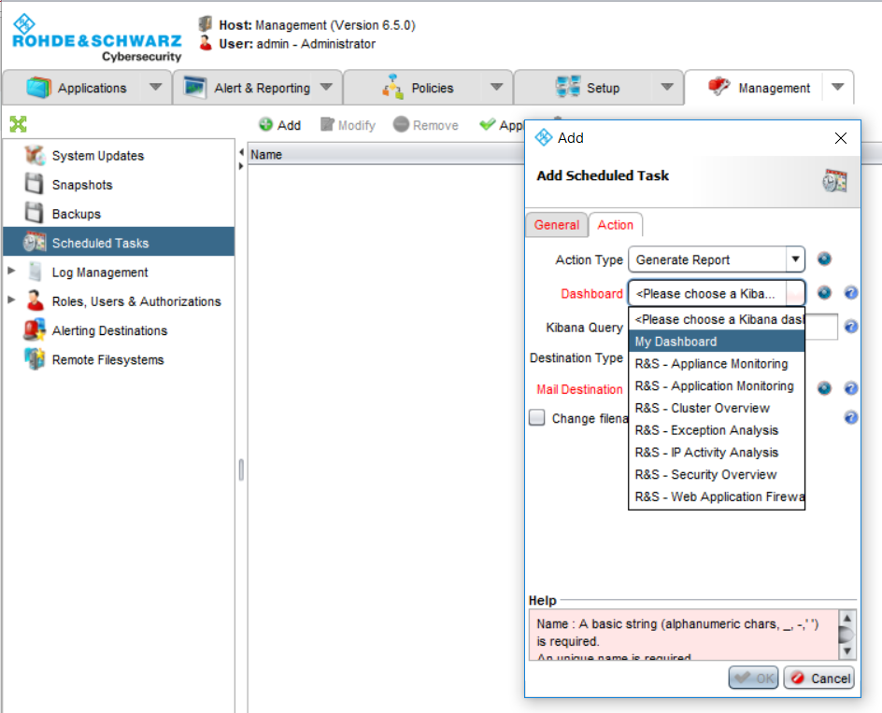
Create new dashboard (2/2)
Save the result
Create a scheduled task to generate a report from the new Dashboard

Slide 43
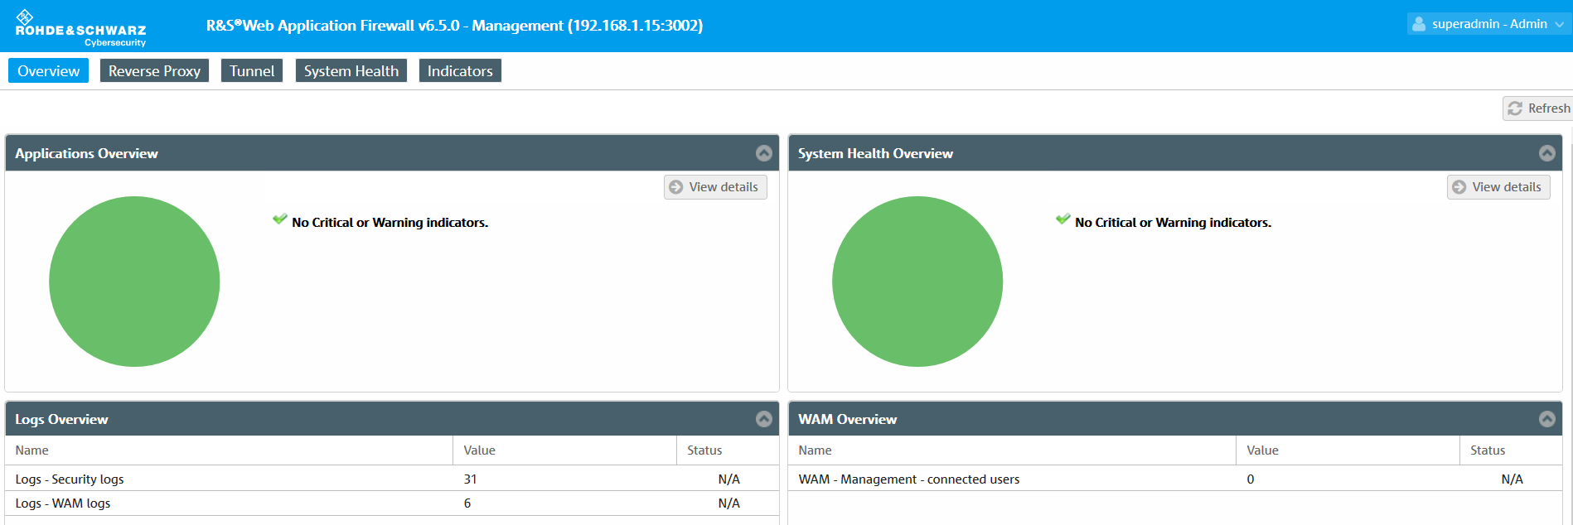
Web Monitoring/Reporting Dashboard
Default URL: https://<managementIP>:3002/

Slide 44
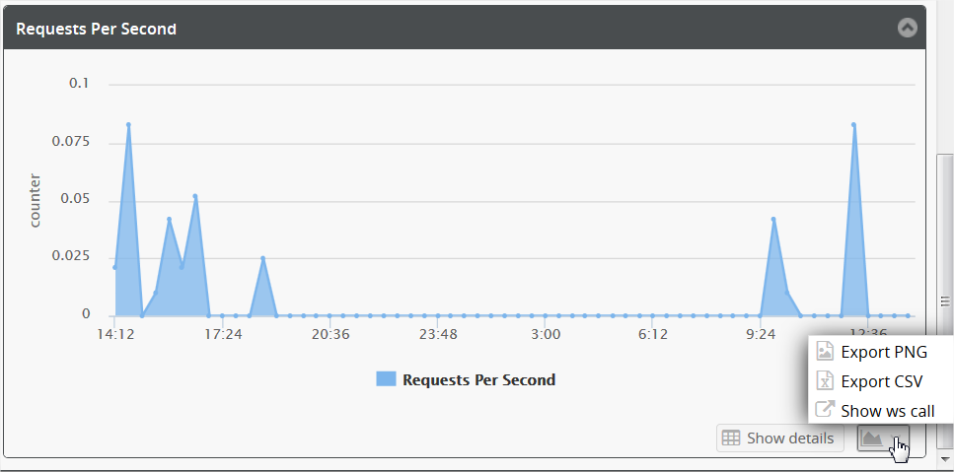
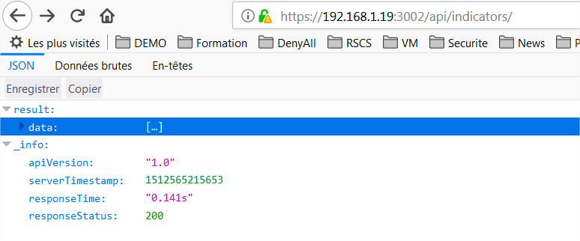
Web Monitoring/Reporting Dashboard
API:
https://<managementIP>:3002/api/indicators/

Slide 45
Question ?

