Slide 1
DenyAll WAF Certifications
Official Training 2018

Slide 2
Presentation
THEORICAL PART
20 Questions in multiple choice format
One or more valid responses
PRACTICAL PART
8 Exercises
60 minutes

Slide 3
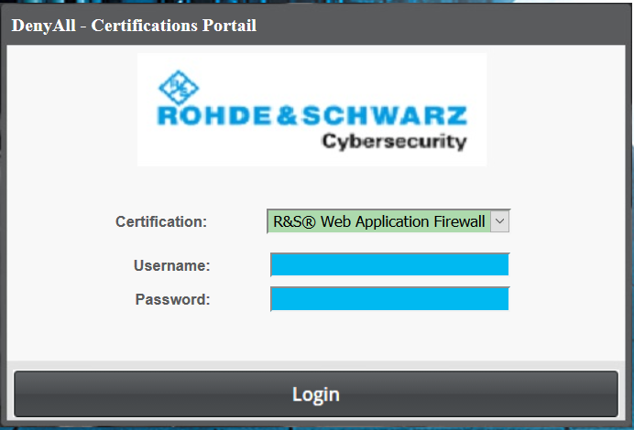
Certification Exam Website
https://certification.denyall.com
Credentials will be sent by email

Slide 4


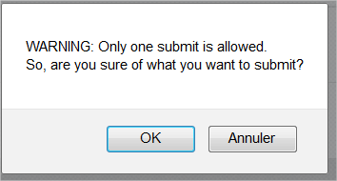

Theorical part
Go on
Answer the questions
Click on submit button at the end

Slide 5

Practical Part
Remove all Tunnels, Application and Reverse Proxies.
Download and restore the backup file
Add and Modify the following line in your host file
<WAF_IP> challenges.denyall-certification.com challenge1.denyall-certification.com challenge2.denyall-certification.com challenge3.denyall-certification.com challenge4.denyall-certification.com challenge5.denyall-certification.com challenge6.denyall-certification.com challenge7.denyall-certification.com challenge8.denyall-certification.com

Slide 6
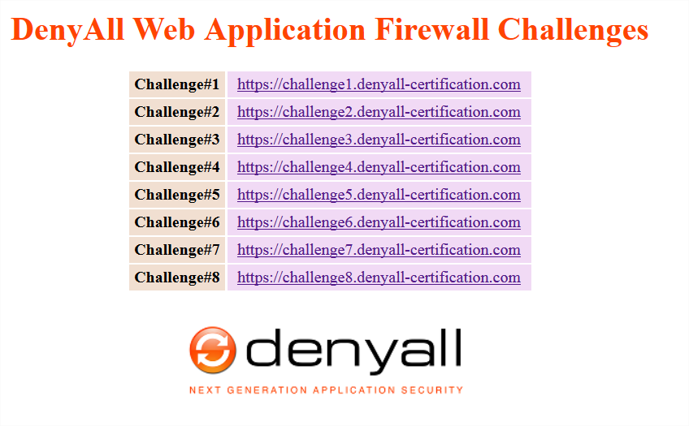
Practical Part
Access to http://challenges.denyall-certification.com

Slide 7
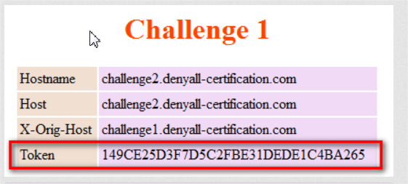
Practical Part
Troubleshoot all tunnels and collect the Tokens
To obtain the correct Token all the headers Host, Hostname, and X-Orig-Host must have the same value corresponding to the tunnel's ServerName

Slide 8
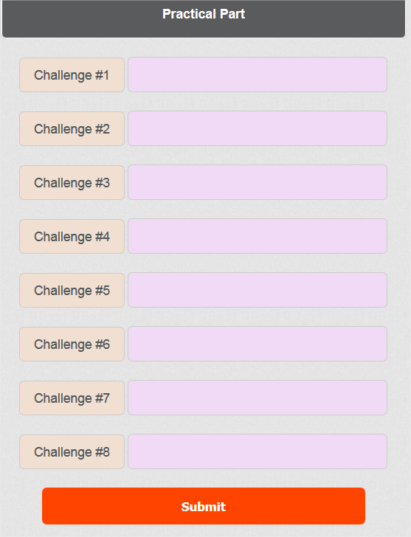
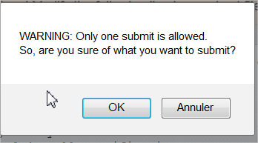

Practical Part
Click on submit button at the end

Slide 9
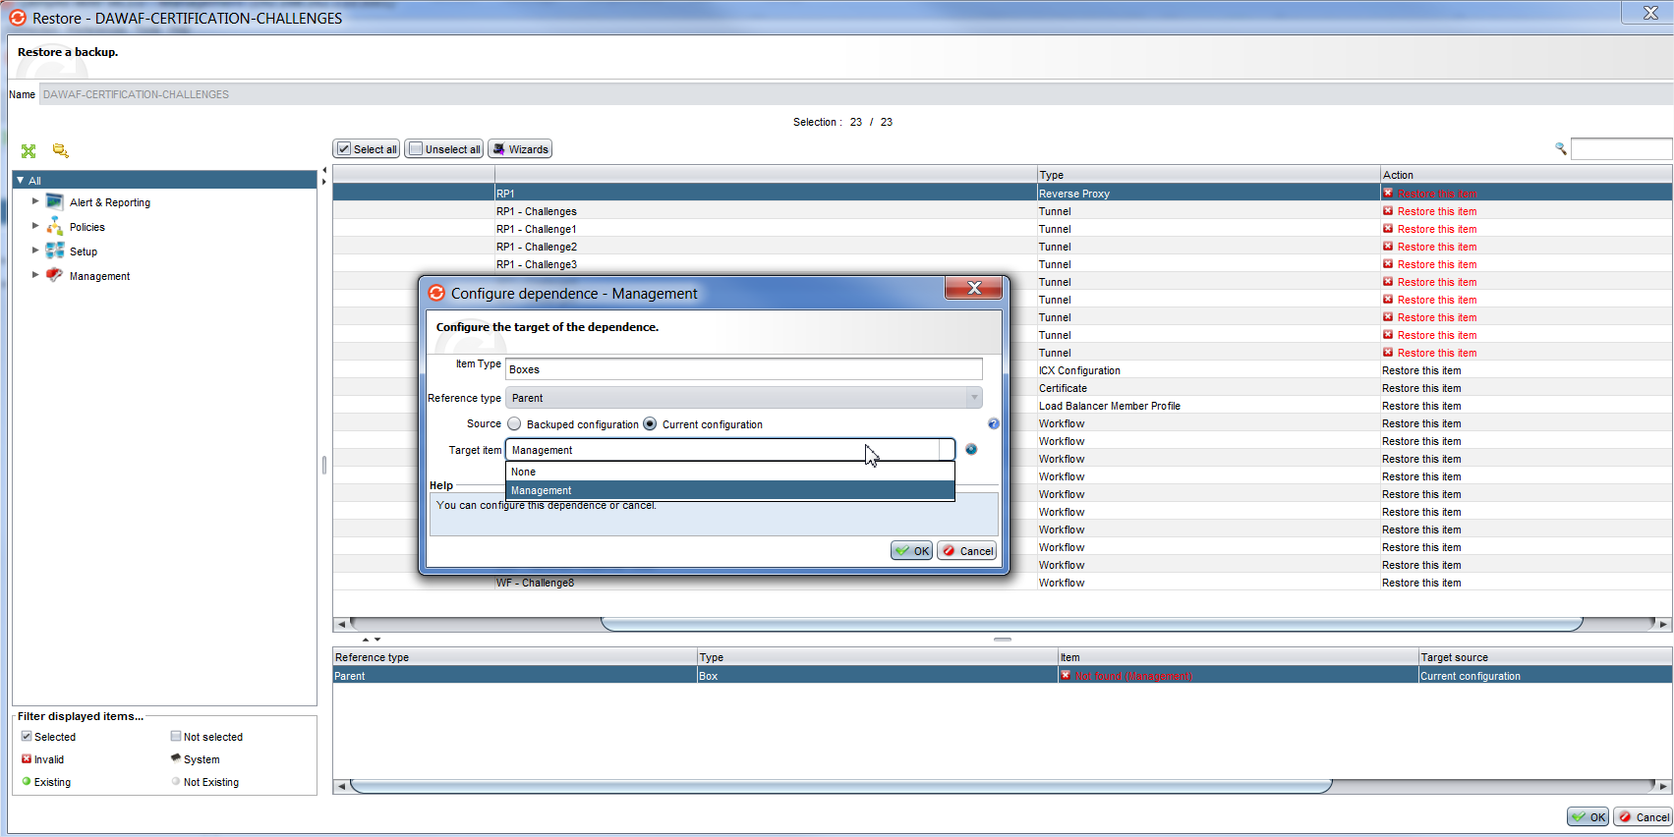
Warning in restore of the backup file
Configure dependence for Reverse Proxy

Slide 10
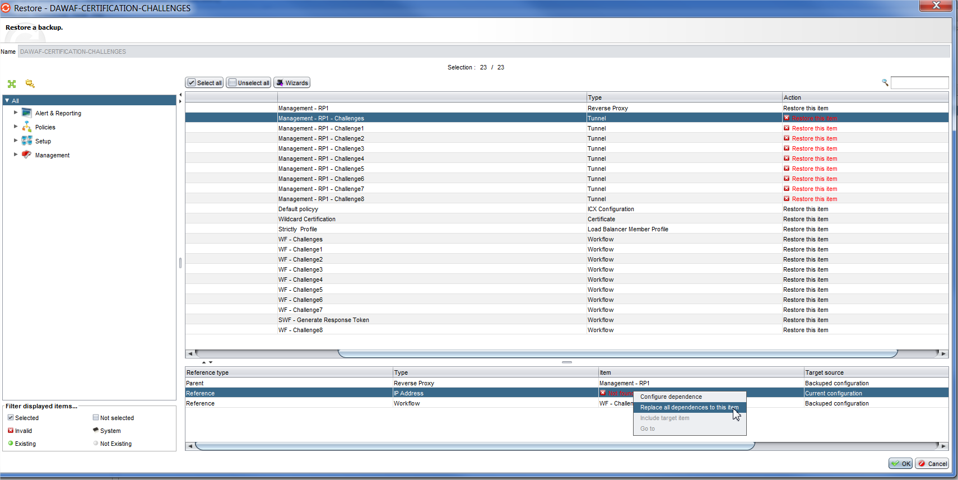
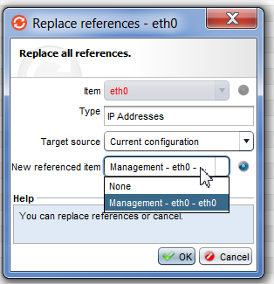
Warning in restore of the backup file
Configure dependence for network

Slide 11
Good Luck !!

